Slide 1
ML for Biomedicine

Slide 2
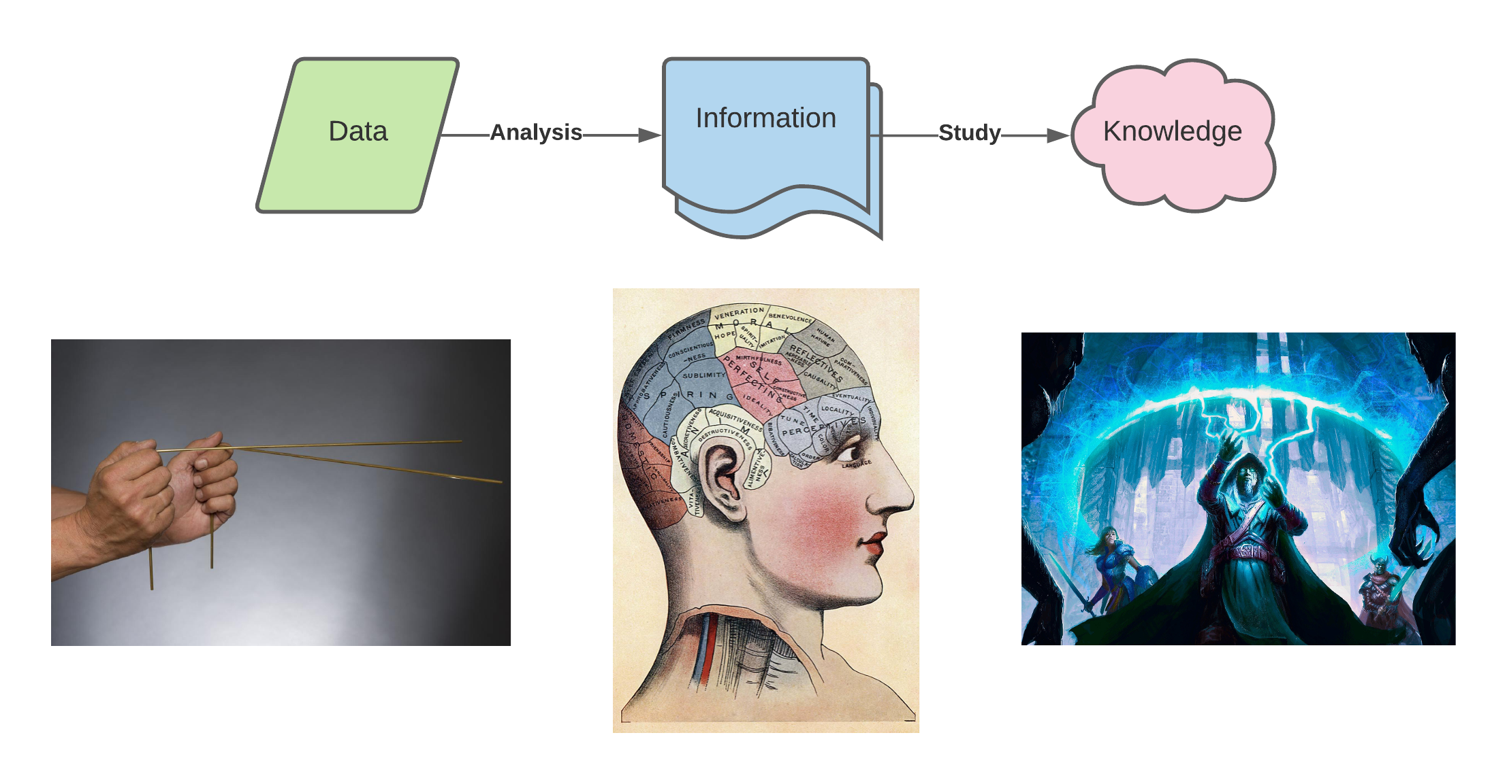
Distinguishing Data, Information, and Knowledge
Scientific Data are values obtained by measurement. -> Observations
Information is useful demonstrable facts about data. -> Relationships
Knowledge is inferred statements about how nature works. -> Applications

Slide 3
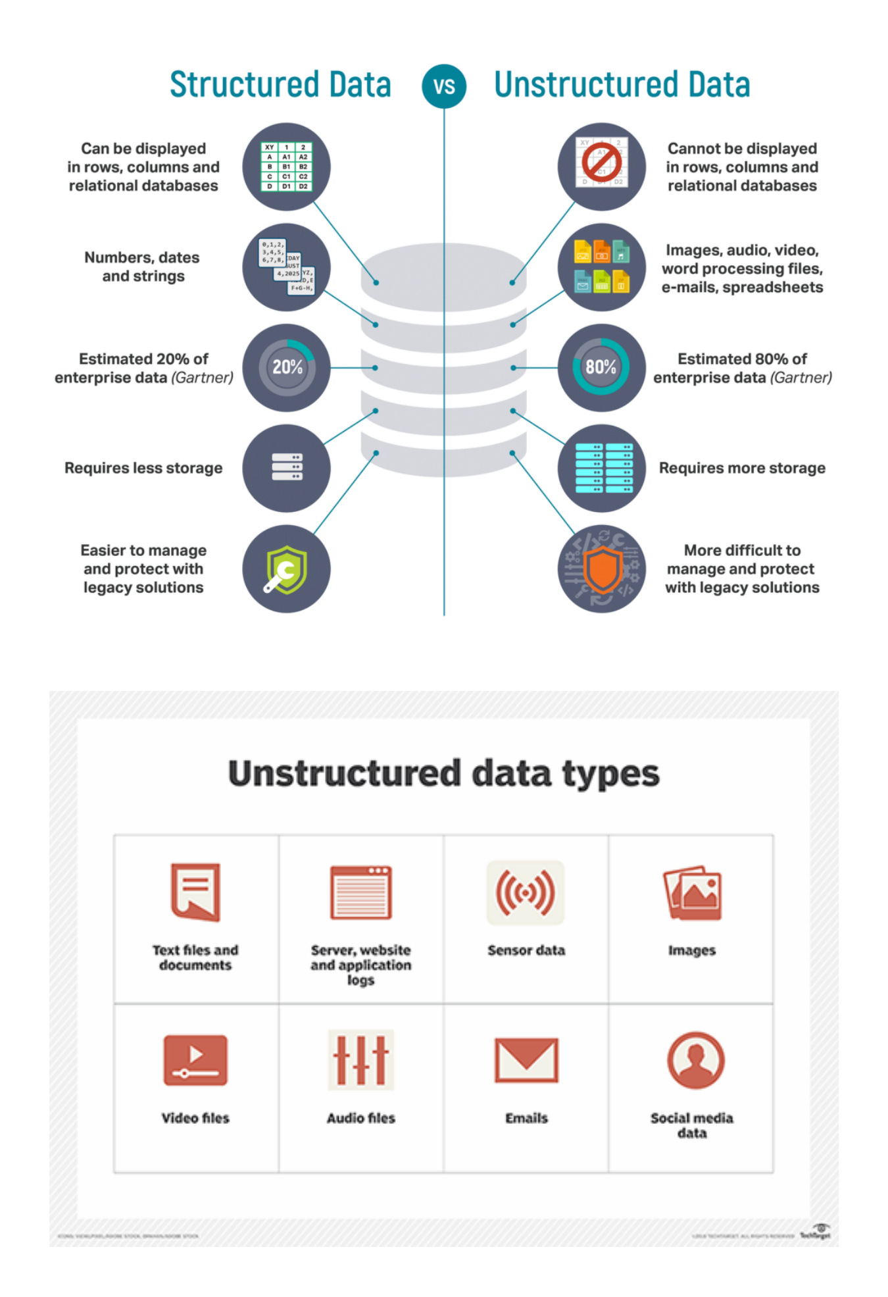
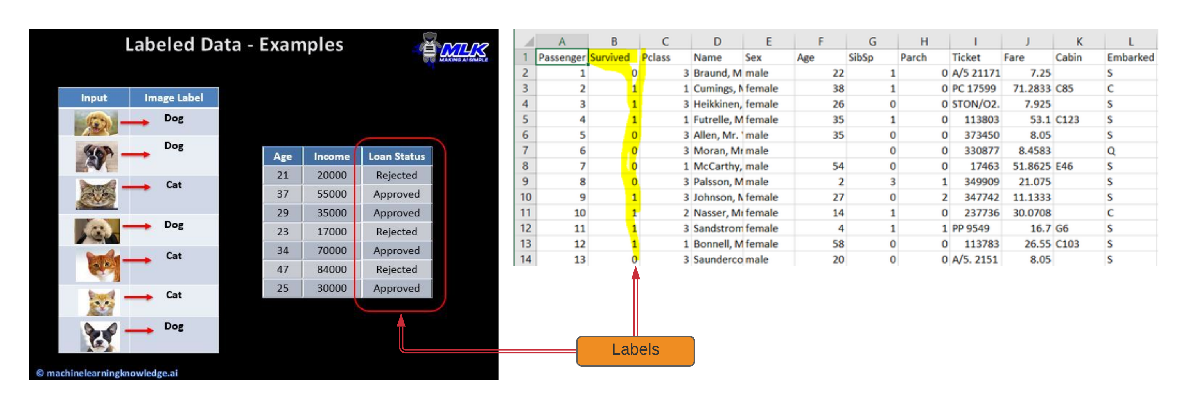
What is data?
Often visualized as observations and features in some spreadsheet. Structured
Most data is un-structured. (lab notes, numbers mixed with descriptive prose)
Sometimes observations are linked to known outcomes. Paired or Labeled data

Slide 4


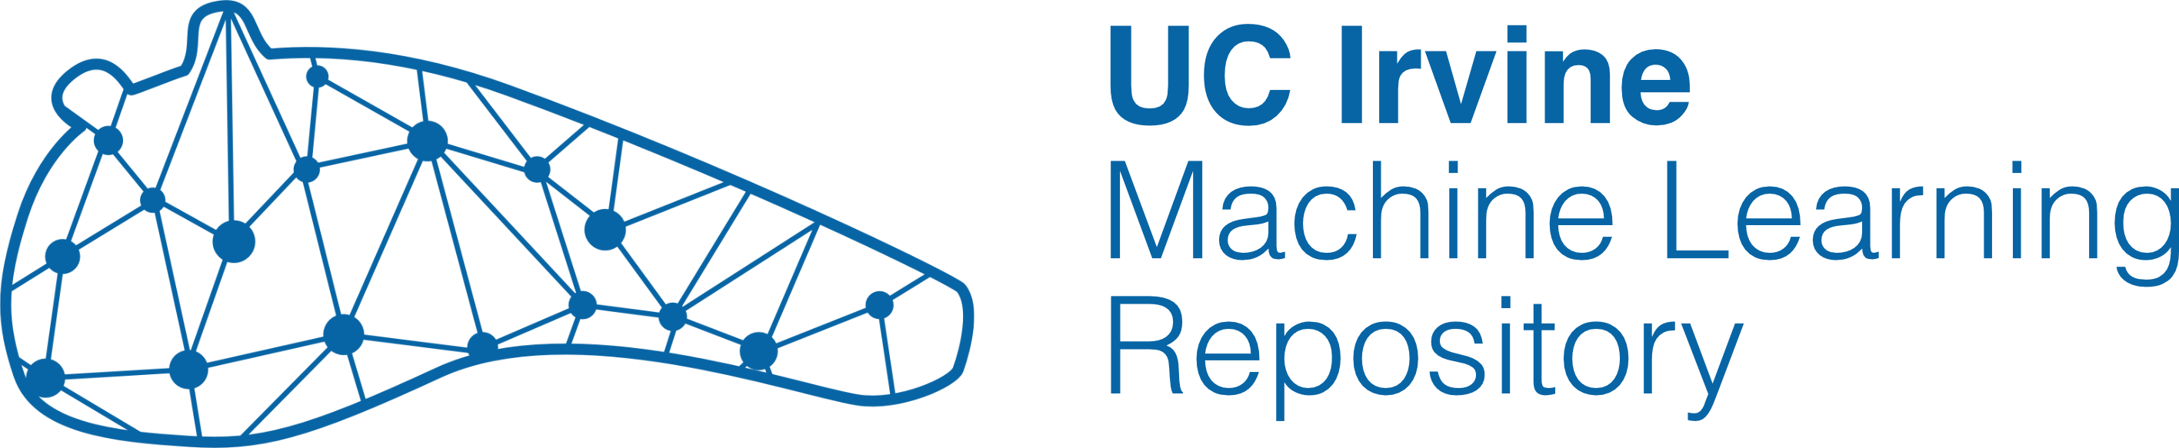
Fantastic Data and where to find them
https://www.kaggle.com/
http://www.ics.uci.edu/~mlearn/MLRepository.html
https://archive-beta.ics.uci.edu/
https://www.quandl.com/
Usual UX is to search databases by:
Task – Regression, Clustering, Classification
Domain – Life sciences, Physical sciences, Social sciences …
Size – Number of Observations, Features, or Outcomes

Slide 5
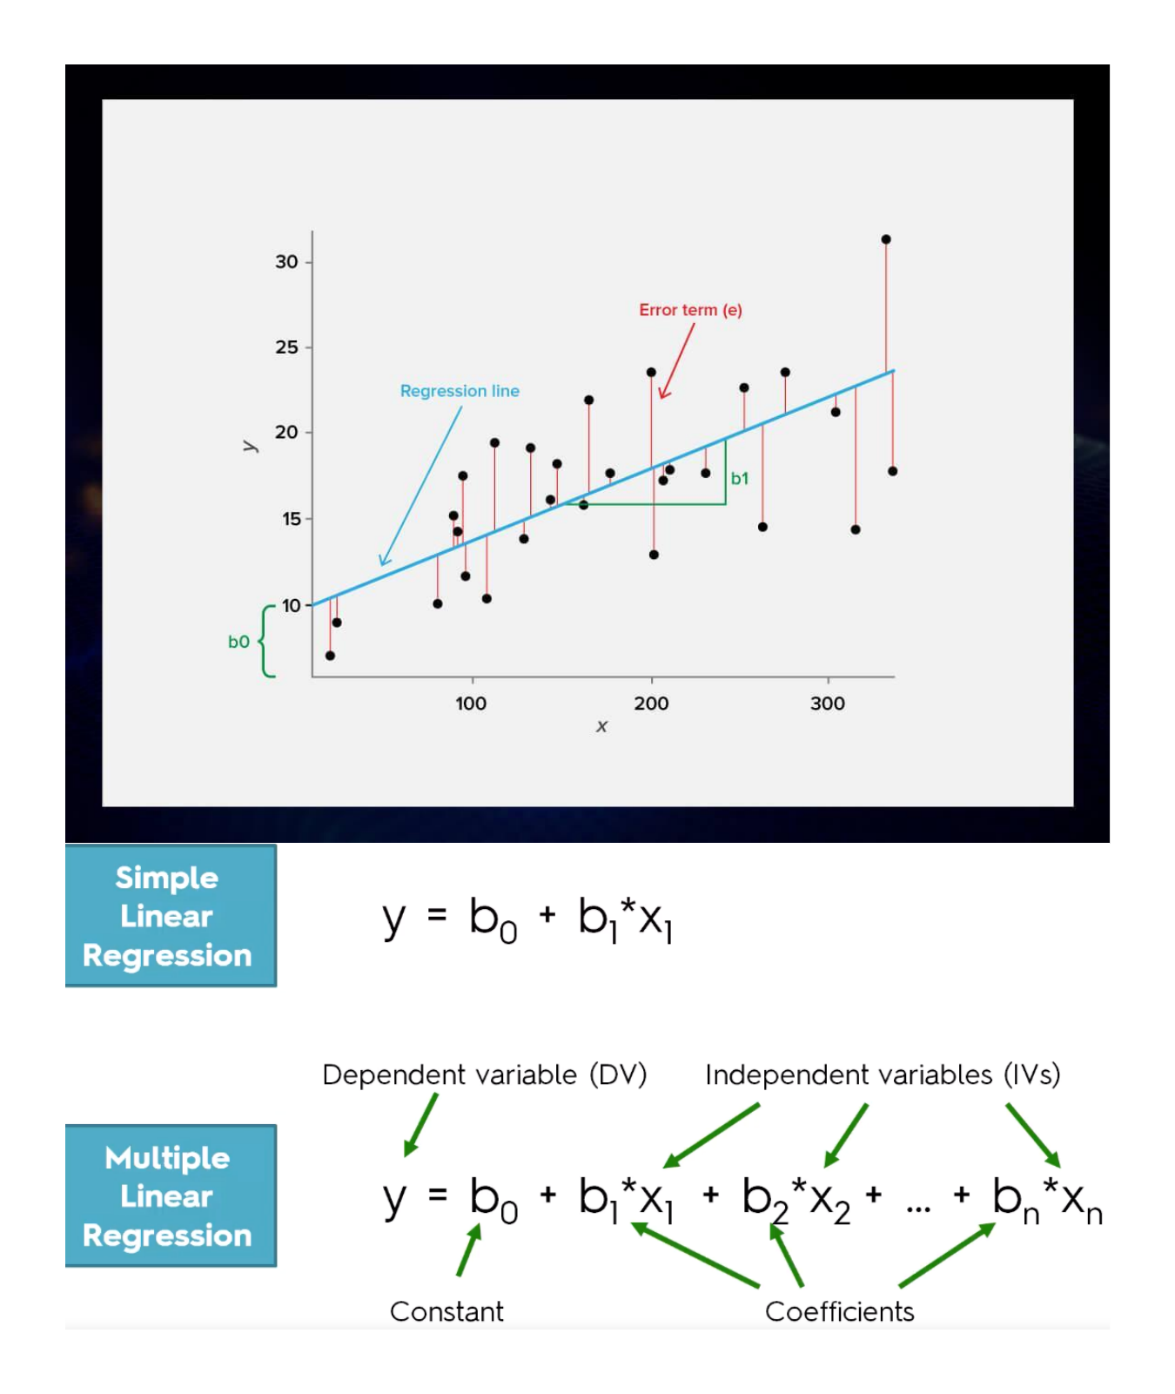
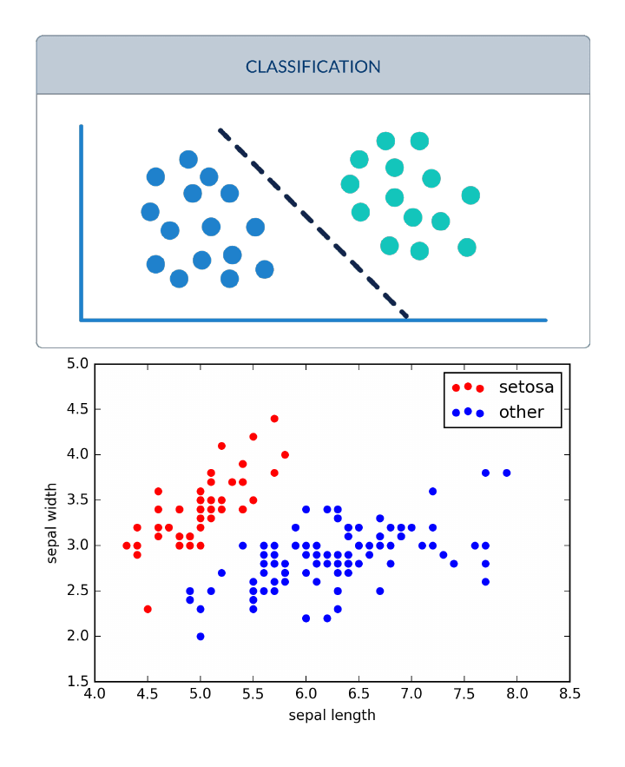
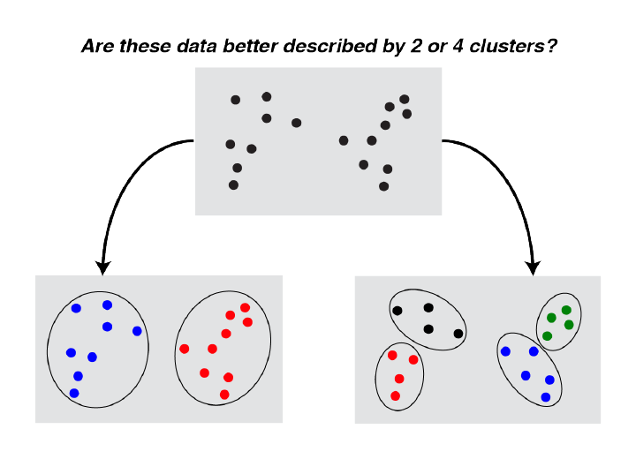
Regression, Classification, and Clustering
Continuous Paired Data
Categorical Labels
Unlabeled Data

Slide 6
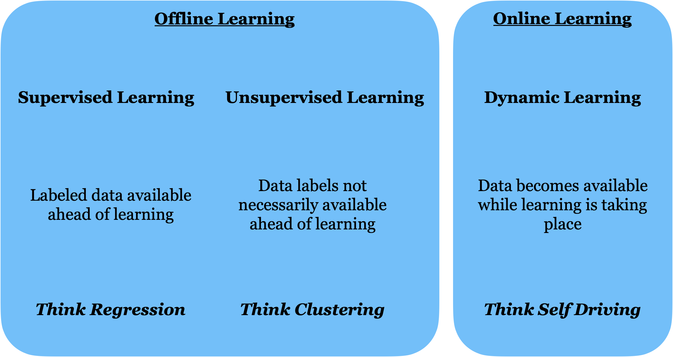
Types of Machine Learning

Slide 7
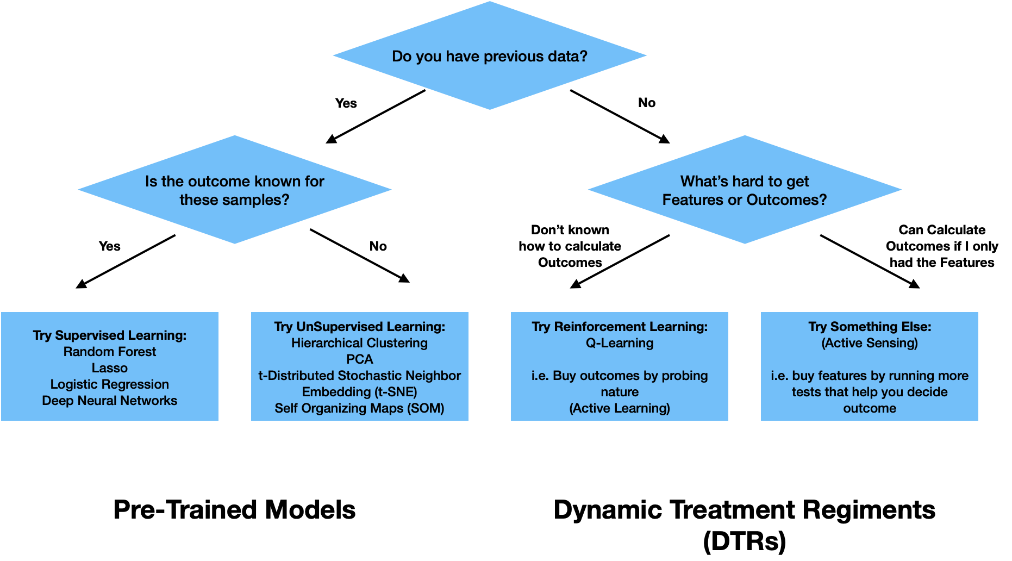
How do I know what type of learning is best?

Slide 8
Autism screening in Children
Brief:
Autism spectrum disorder (ASD) is associated with life-long healthcare costs. This can be mitigated by early diagnosis. Meanwhile, rate of cases are increasing. Presently, very limited autism datasets associated with clinical or screening are available and most of them are genetic in nature. Hence, we propose a new dataset related to autism screening of adults that contained 20 features to be utilized for further analysis especially in determining influential autistic traits and improving the classification of ASD cases.
Dataset sourced from UCI ML archive:
https://archive.ics.uci.edu/ml/datasets/Autistic+Spectrum+Disorder+Screening+Data+for+Children++#
Relevant Papers:
Thabtah, F. (2017). Autism Spectrum Disorder Screening: Machine Learning Adaptation and DSM-5 Fulfillment. Proceedings of the 1st International Conference on Medical and Health Informatics 2017, pp.1-6. Taichung City, Taiwan, ACM.
Thabtah, F. (2017). ASDTests. A mobile app for ASD screening. www.asdtests.com [accessed December 20th, 2017].
Thabtah, F. (2017). Machine Learning in Autistic Spectrum Disorder Behavioural Research: A Review. To Appear in Informatics for Health and Social Care Journal. December, 2017 (in press)

Slide 9
Data description distributed along with data
Task: Classification
Attribute Type: Categorical, continuous and binary
Area: Medical, health and social science
Format Type: Non-Matrix
Does your data set contain missing values? Yes
Number of Instances (records in your data set): 292
Number of Attributes (fields within each record): 21
Relevant Information: For Further information about the attributes/feature see below table

Slide 10
Data description distributed along with data
Attribute | Type | Description
Age | Number | years
Gender | String | Male or Female
Ethnicity | String | List of common ethnicities in text format
Born with jaundice | Boolean (yes or no) | Whether the case was born with jaundice
Family member with PDD | Boolean (yes or no) | Whether any immediate family member has a PDD
Who is completing the test | String | Parent, self, caregiver, medical staff, clinician ,etc.
Country of residence | String | List of countries in text format
Used the screening app before | Boolean (yes or no) | Whether the user has used a screening app
Screening Method Type | Integer (0,1,2,3) | The type of screening methods chosen based on age category (0=toddler, 1=child, 2= adolescent, 3= adult)
Question 1 Answer | Binary (0, 1) | The answer code of the question based on the screening method used
Question 2 Answer | Binary (0, 1) | The answer code of the question based on the screening method used
Question 3 Answer | Binary (0, 1) | The answer code of the question based on the screening method used
Question 4 Answer | Binary (0, 1) | The answer code of the question based on the screening method used
Question 5 Answer | Binary (0, 1) | The answer code of the question based on the screening method used
Question 6 Answer | Binary (0, 1) | The answer code of the question based on the screening method used
Question 7 Answer | Binary (0, 1) | The answer code of the question based on the screening method used
Question 8 Answer | Binary (0, 1) | The answer code of the question based on the screening method used
Question 9 Answer | Binary (0, 1) | The answer code of the question based on the screening method used
Question 10 Answer | Binary (0, 1) | The answer code of the question based on the screening method used
Screening Score | Integer | The final score obtained based on the scoring algorithm of the screening method used. This was computed in an automated manner

Slide 11
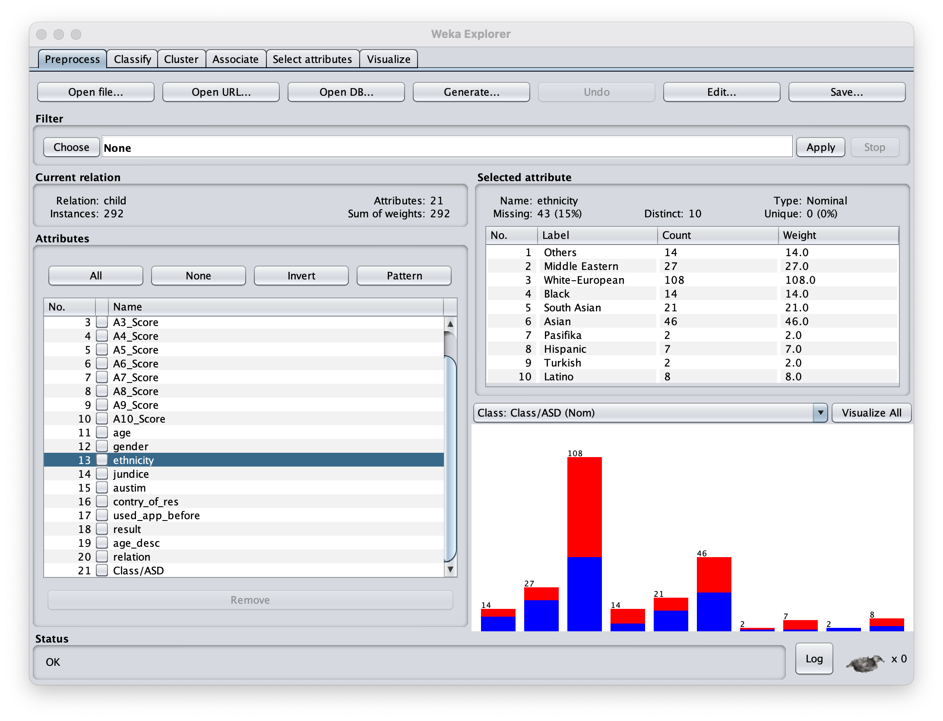
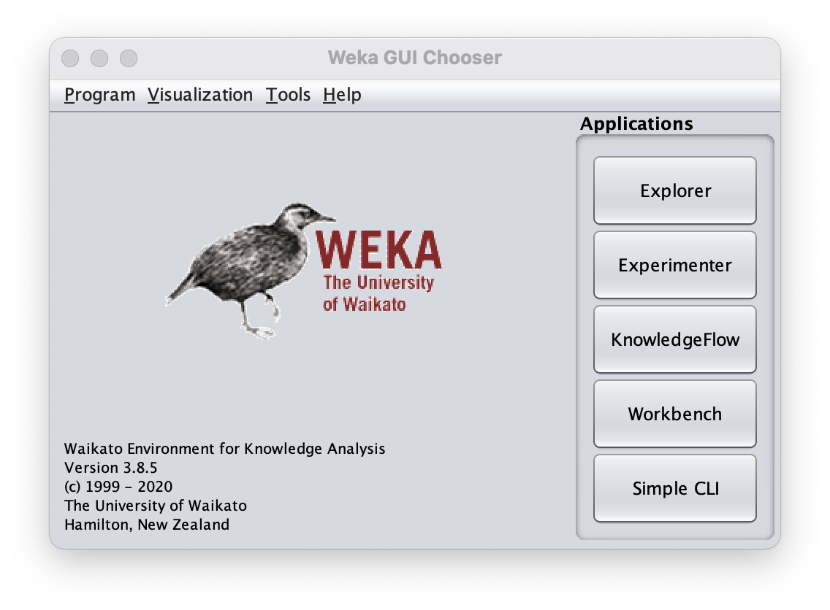
Weka for EDA
Download Weka here https://waikato.github.io/weka-wiki/downloading_weka/
Run explorer
Summarize feature (attributes) and view distribution by Label: (cases in red)
(ctrl in blue)
Label (Class) is always the last variable
Check out this great Weka tutorial by Google!
https://www.youtube.com/watch?v=TF1yh5PKaqI

Slide 12
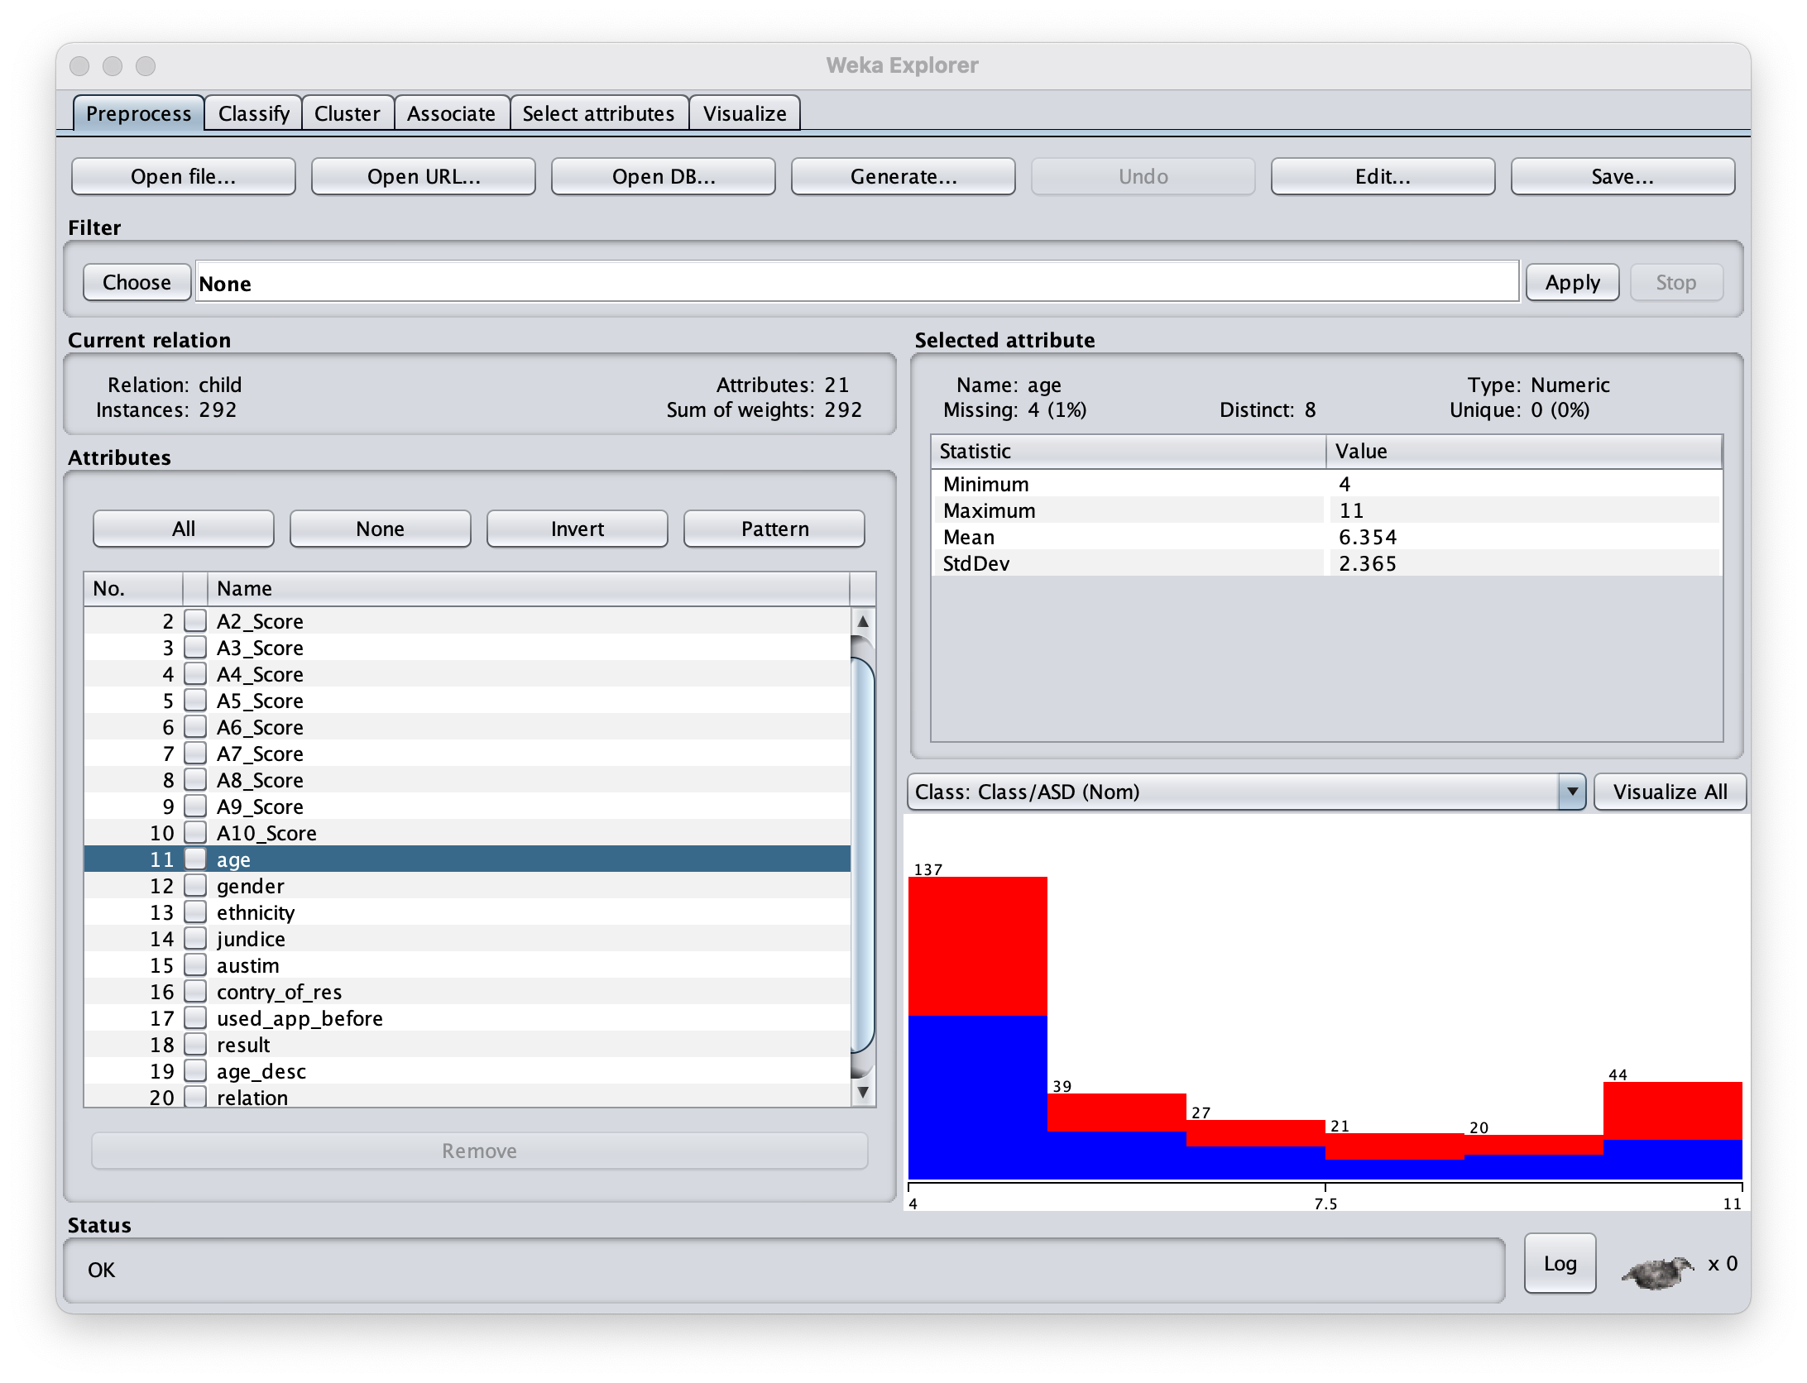
Weka for EDA
Let’s look at AGE
Looks like there are only 8 distinct ages.
No Age is unique.
4 Age values are missing.
Looks like prevelance of cases is 50% for all age groups.
Age groups are not normally or uniformly sampled.

Slide 13
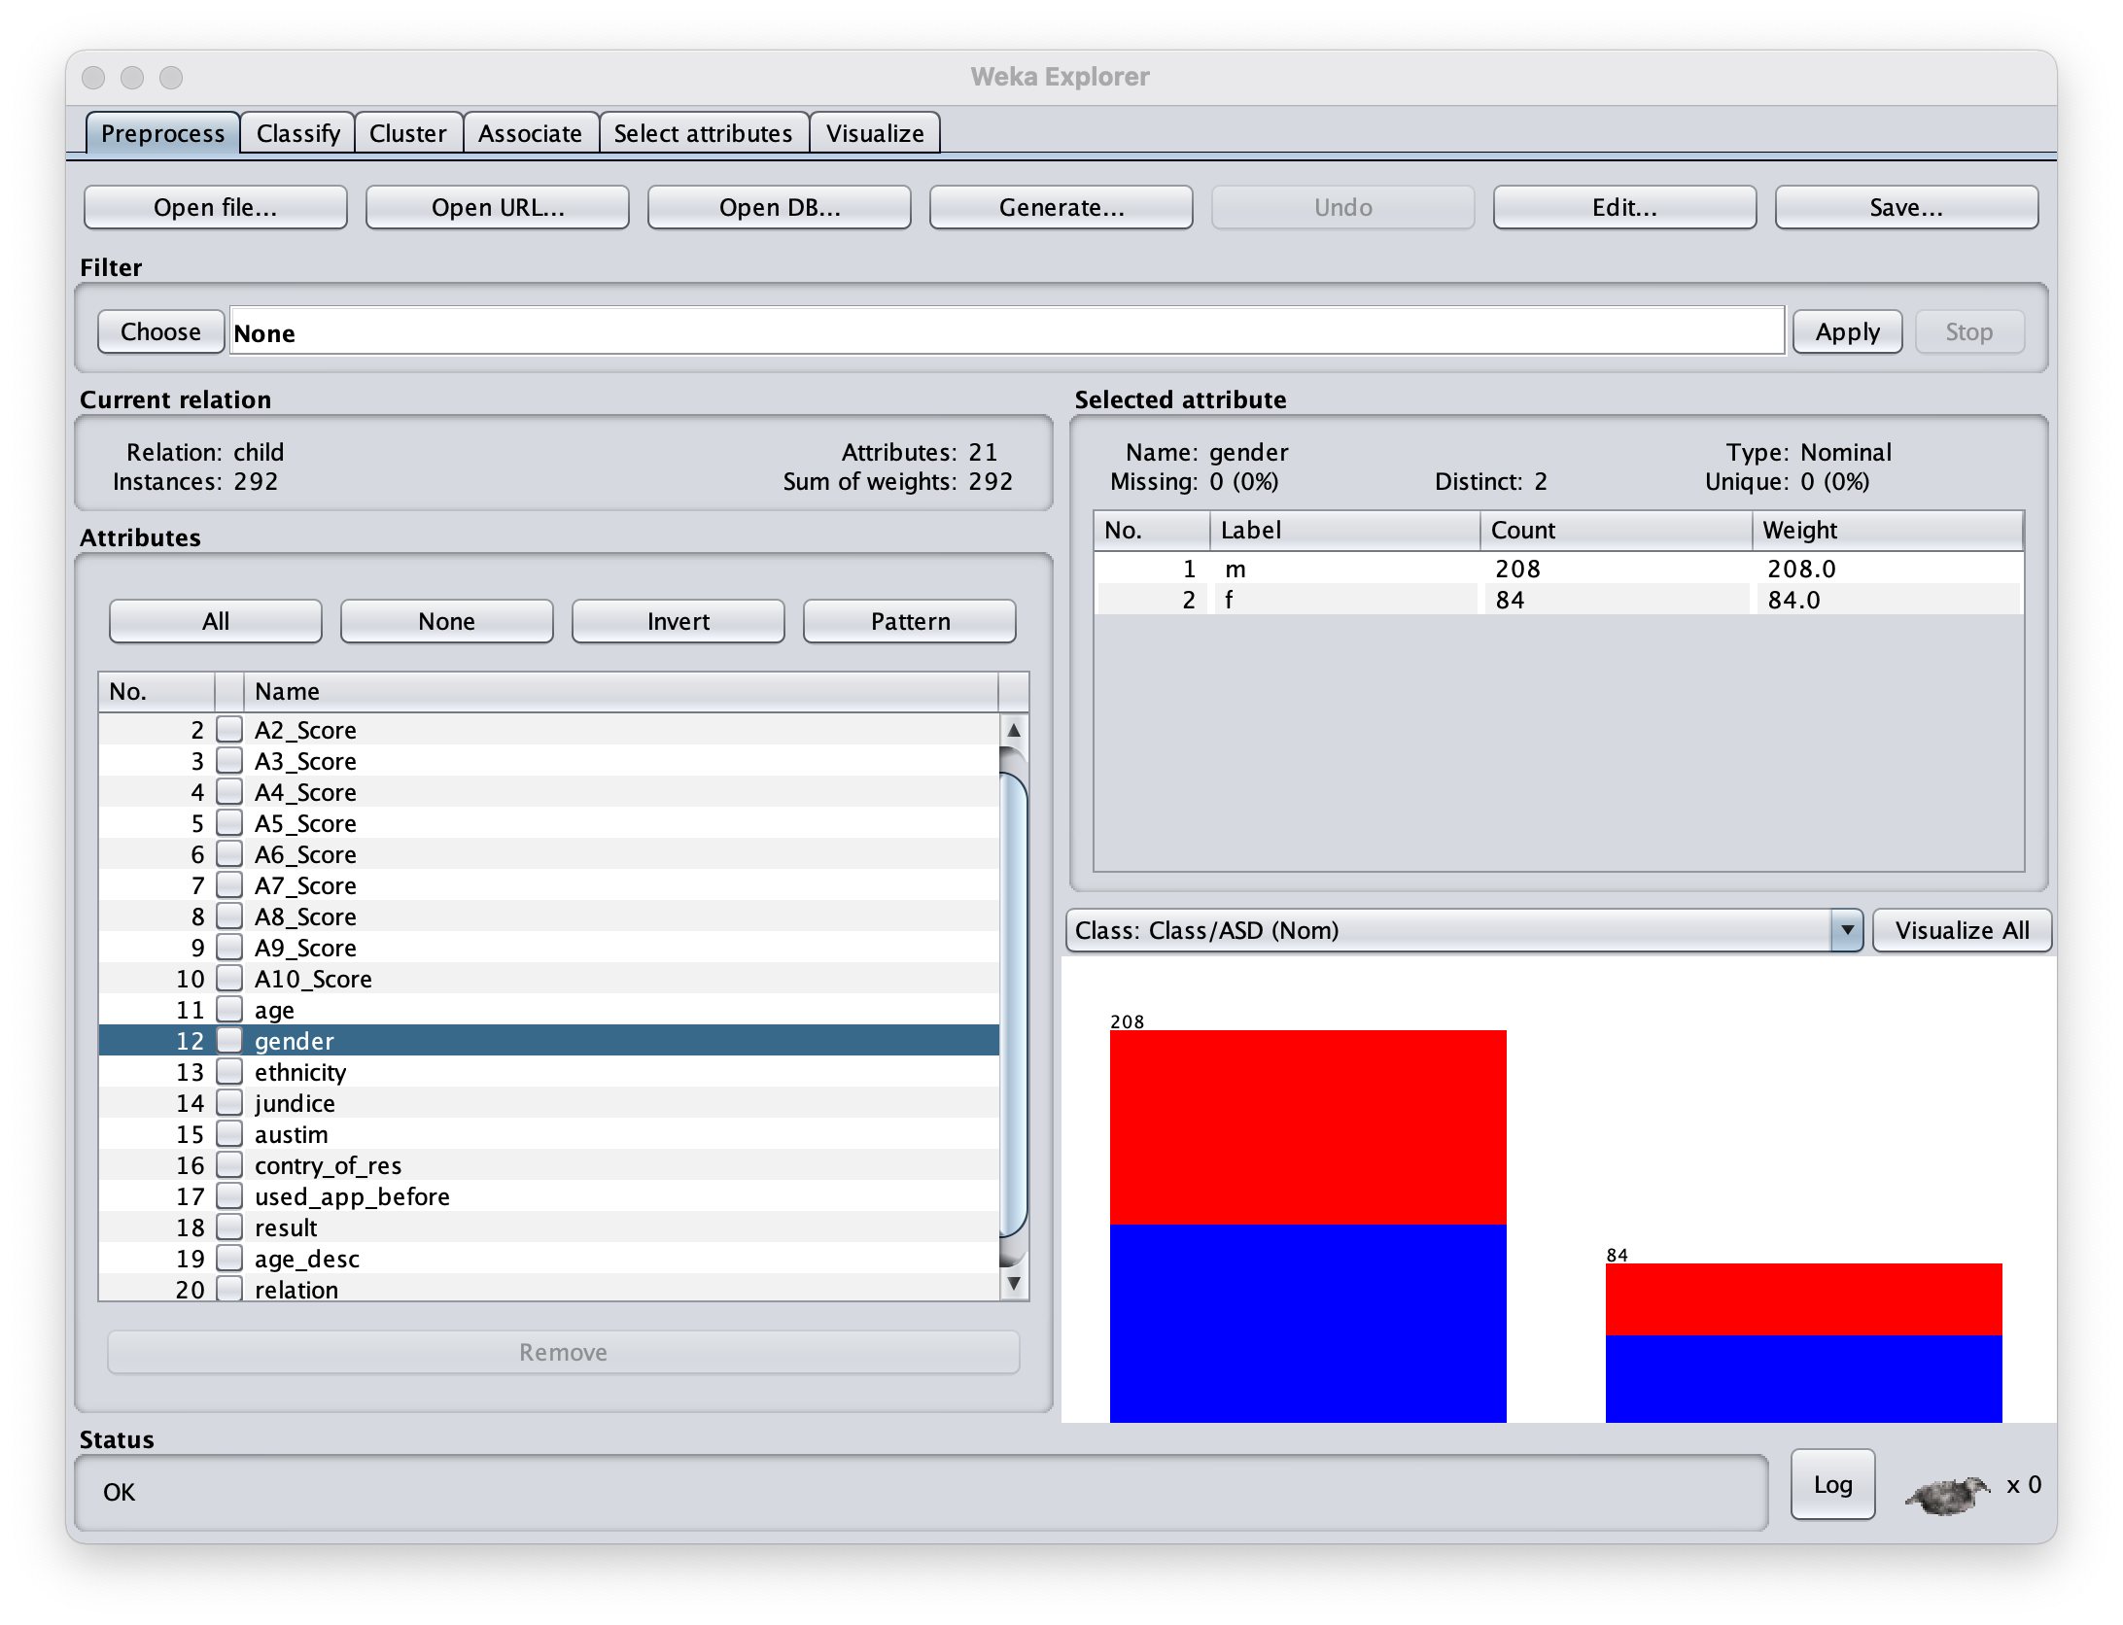
Weka for EDA
What about gender:
Twice as many Males as Females
Looks like prevalence of cases is 50% for both sexes.

Slide 14

Weka for EDA
And Ethnicity:
Looks like 10 ethnic groups are represented.
Ethnicity is unknown for 15% of patients.
Most patients are White.
Nearly all Hispanic patients are autistic.

Slide 15
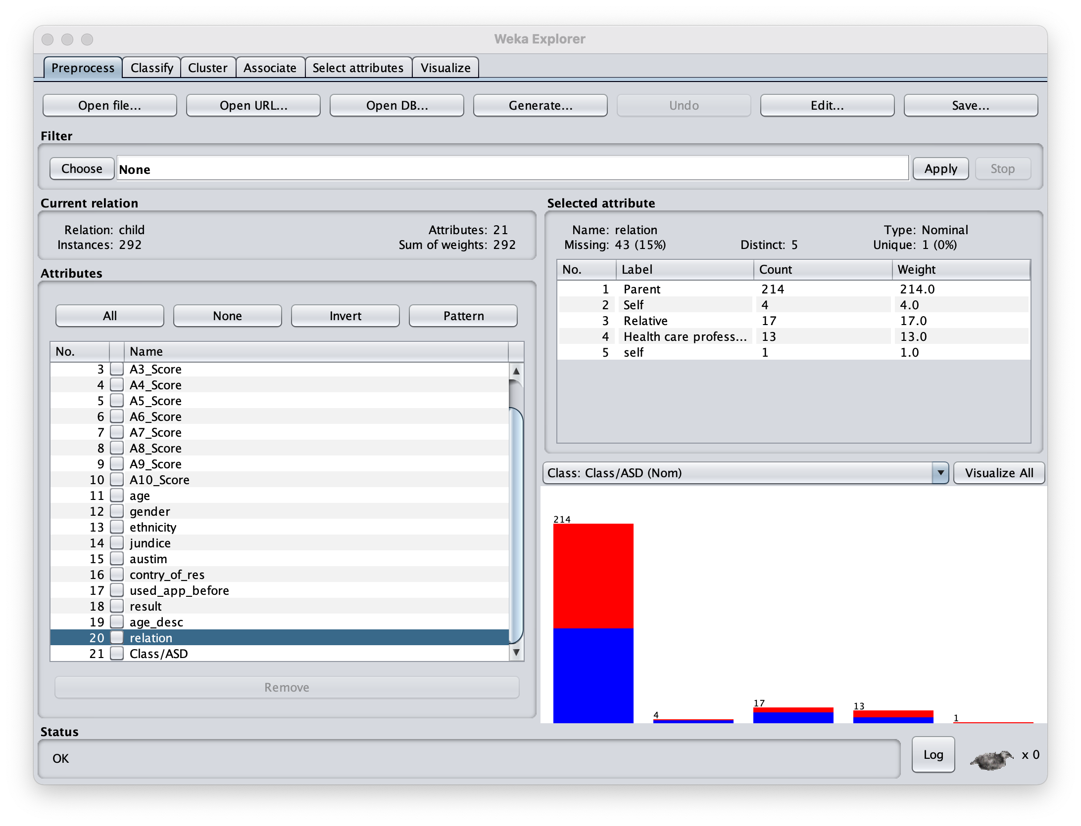
Weka for EDA
Why not, let’s look at who’s filling out the form:
Luckily only 5 groups
Most are Parents.
Ugh… ”self” and “Self”
And we don’t know who filled out 15% of the forms

Slide 16
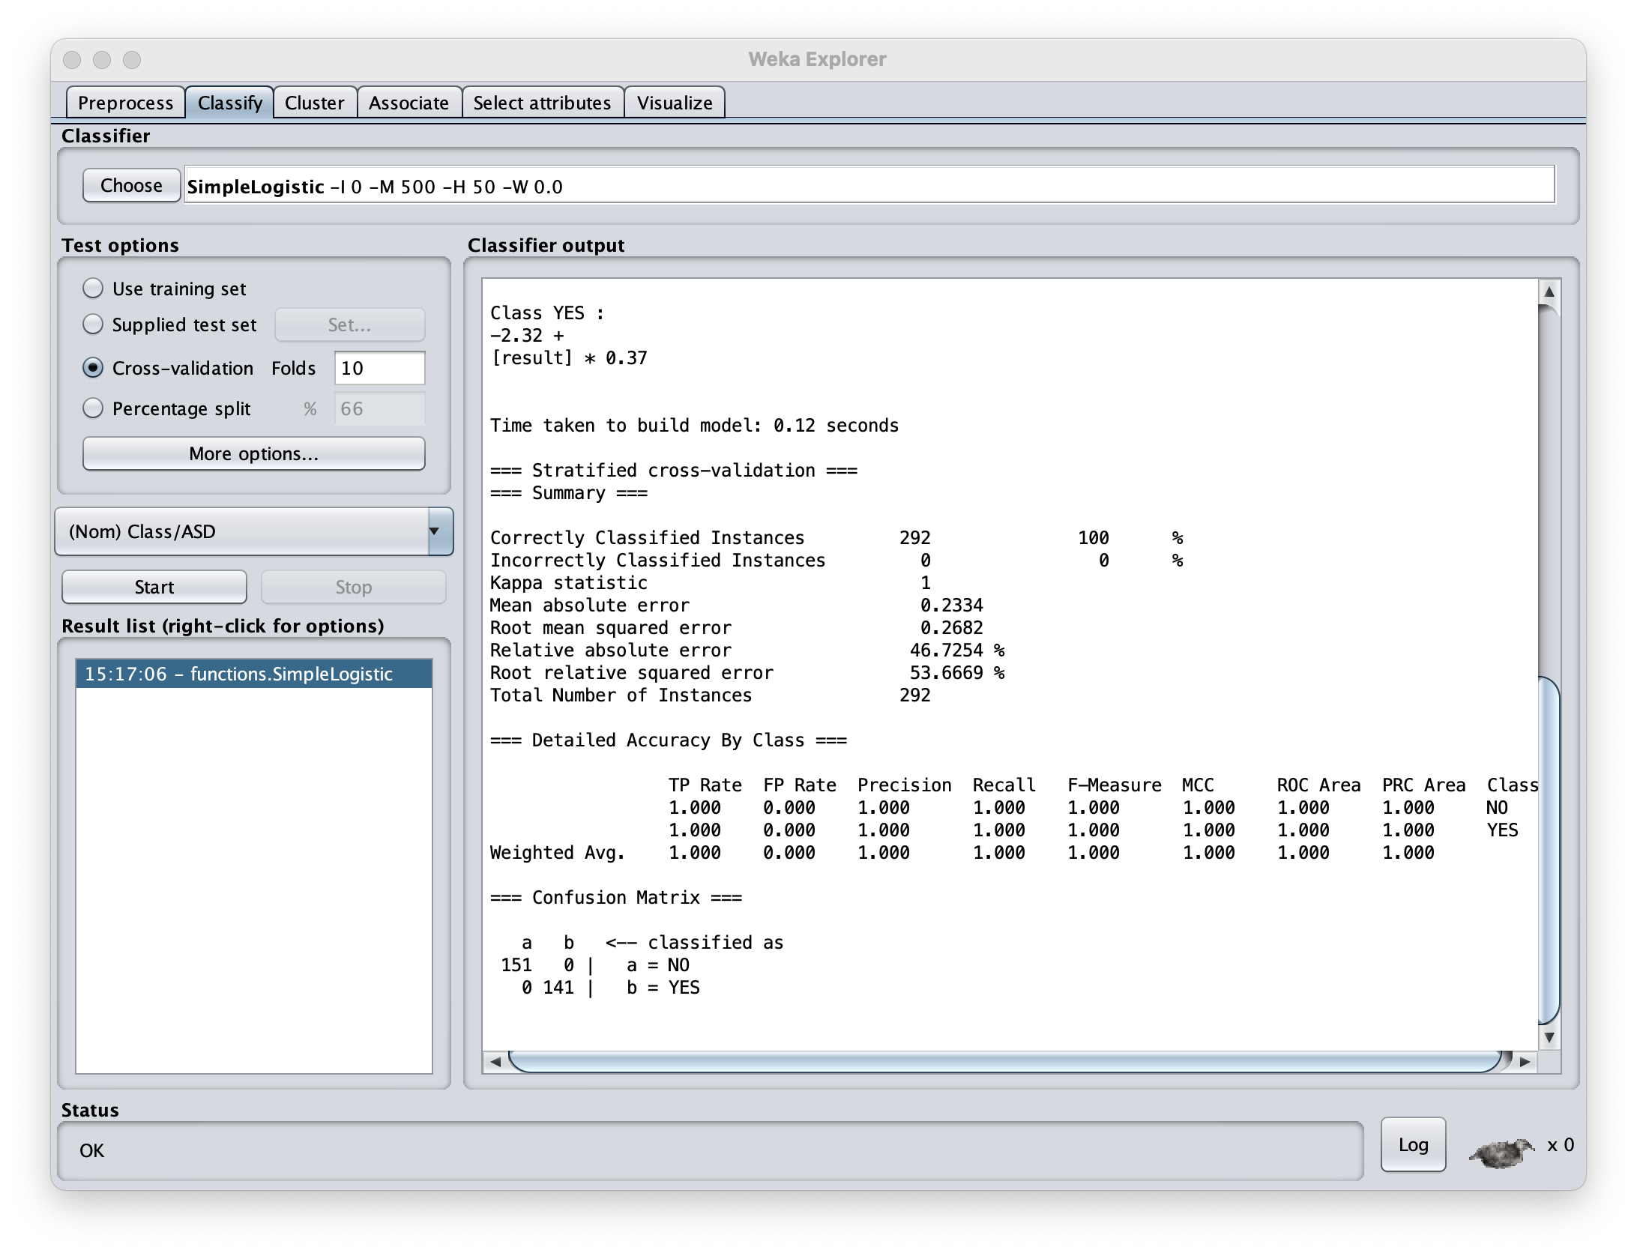

I’m too busy for EDA – just hit classify already
Let’s try some logistic regression to predict the binary Autism outcome:
SimpleLogistic will remove uninformative features and select the most predictive ones.
No way am I overfitting this – Let’s do 10-fold cross-validation

Slide 17
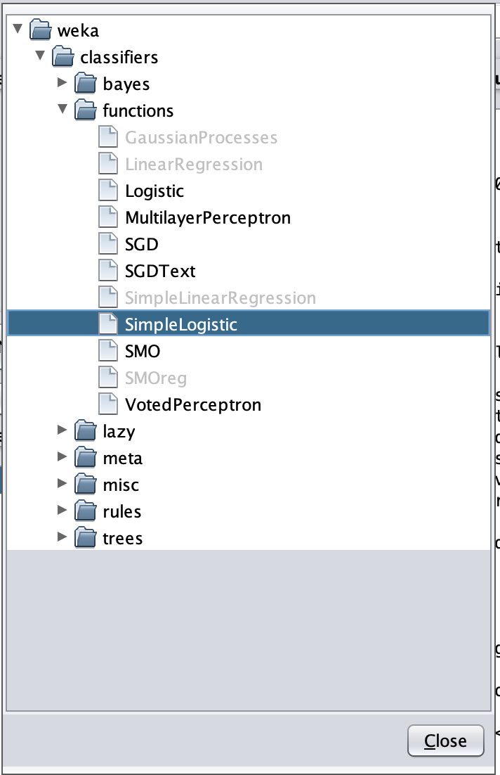
I’m too busy for EDA – just hit classify already
Click: choose -> classifiers -> functions -> SimpleLogistic

Slide 18
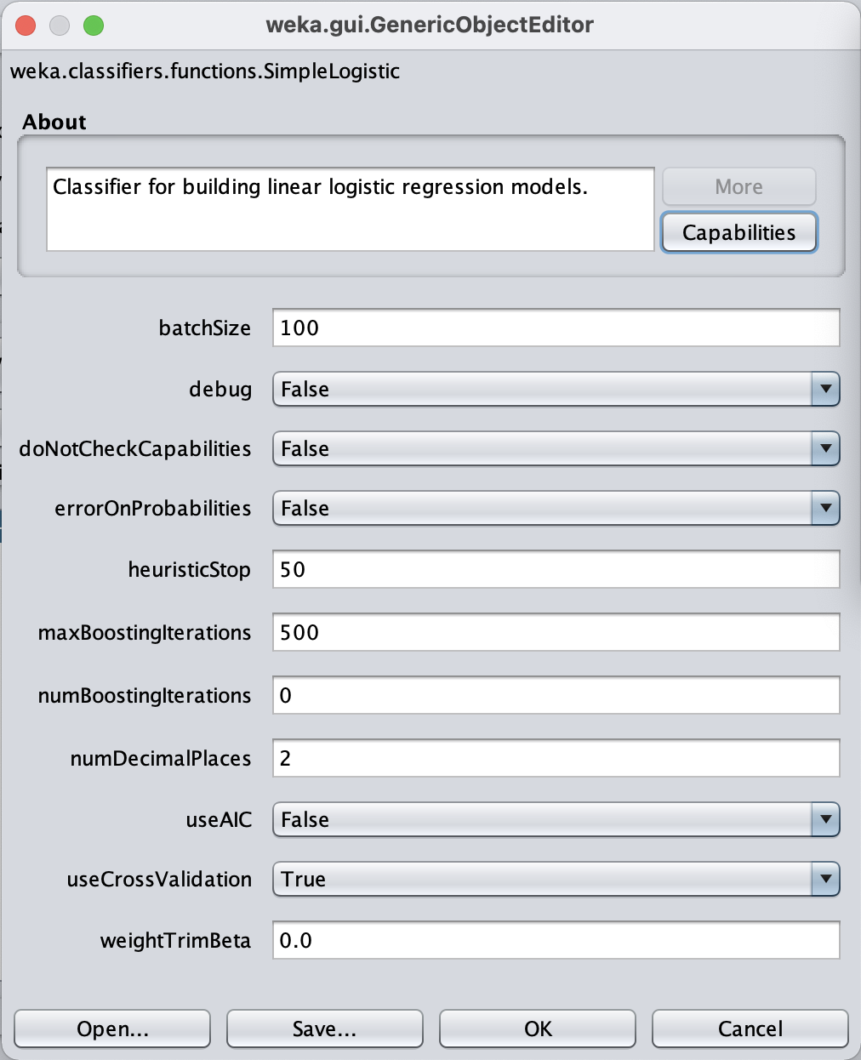
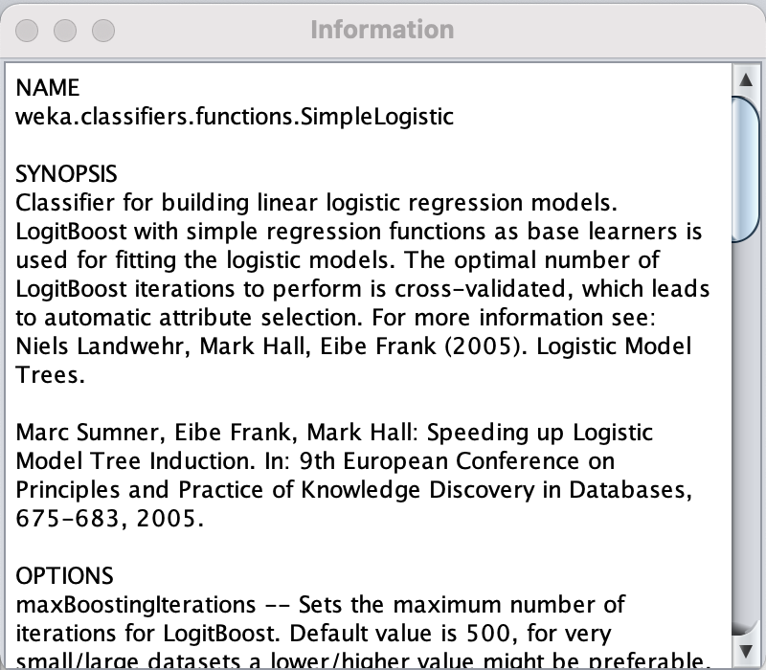
I’m too busy for EDA – just hit classify already
Click on “SimpleLogistic” to bring up the parameters window.
Then, click “More” to expand the About page to get a detailed description of the method.

Slide 19
I’m too busy for EDA – just hit classify already
Simple logistic Regression:
Booyah! Look at that confusion matrix
100% correctly classified Instances
This is the end of the analysis – scroll up to see more.

Slide 20
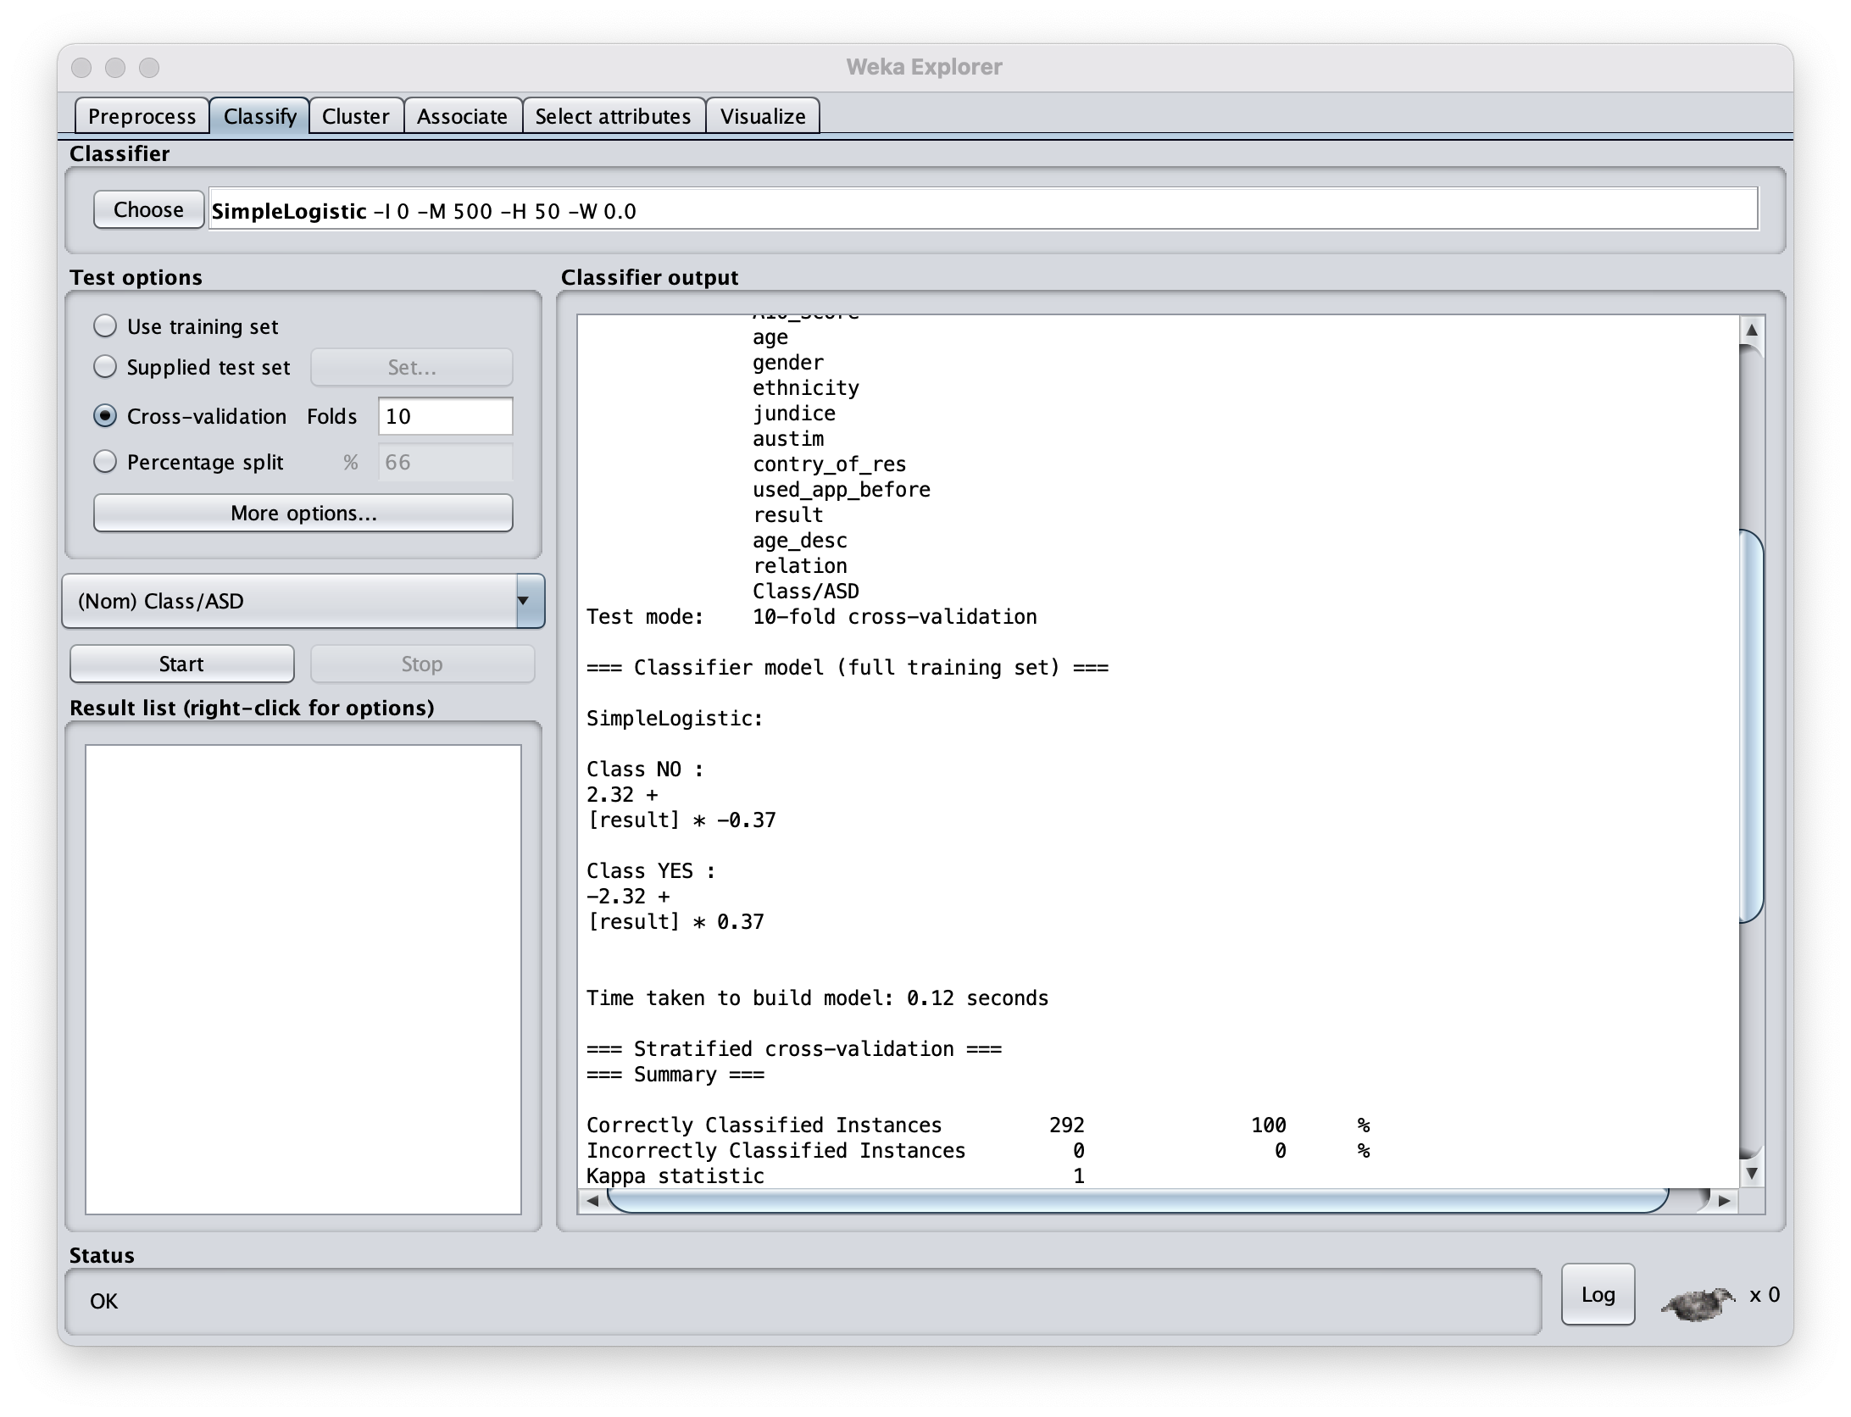
I’m too busy for EDA – just hit classify already
What are the important features:
The result variable for Class NO (ctrl outcome)?
And again the result variable for predicting Class YES (case outcome)?

Slide 21
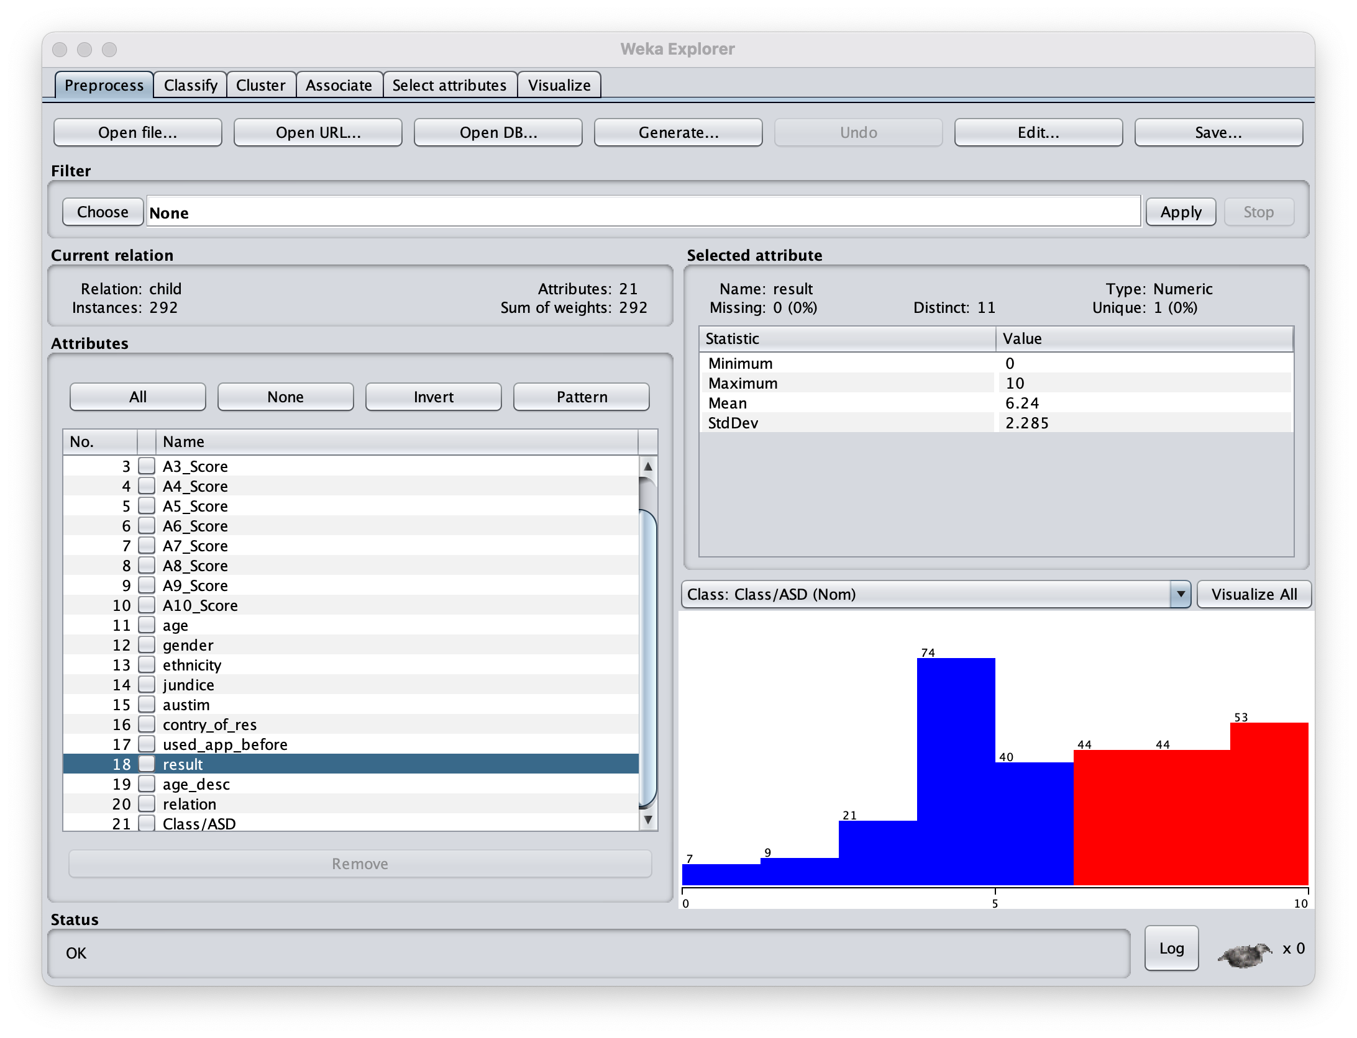
I’m too busy for EDA – just hit classify already
Screening Score | Integer | The final score obtained based on the scoring algorithm of the screening method used. This was computed in an automated manner
What are the important features:
The result variable is the study’s calculated score from 1-10 for predicting
Looks like anything above a 6 predicts Autism… what data did they use?
Let’s remove this feature. Choose -> filters -> unsupervised -> Remove

Slide 22
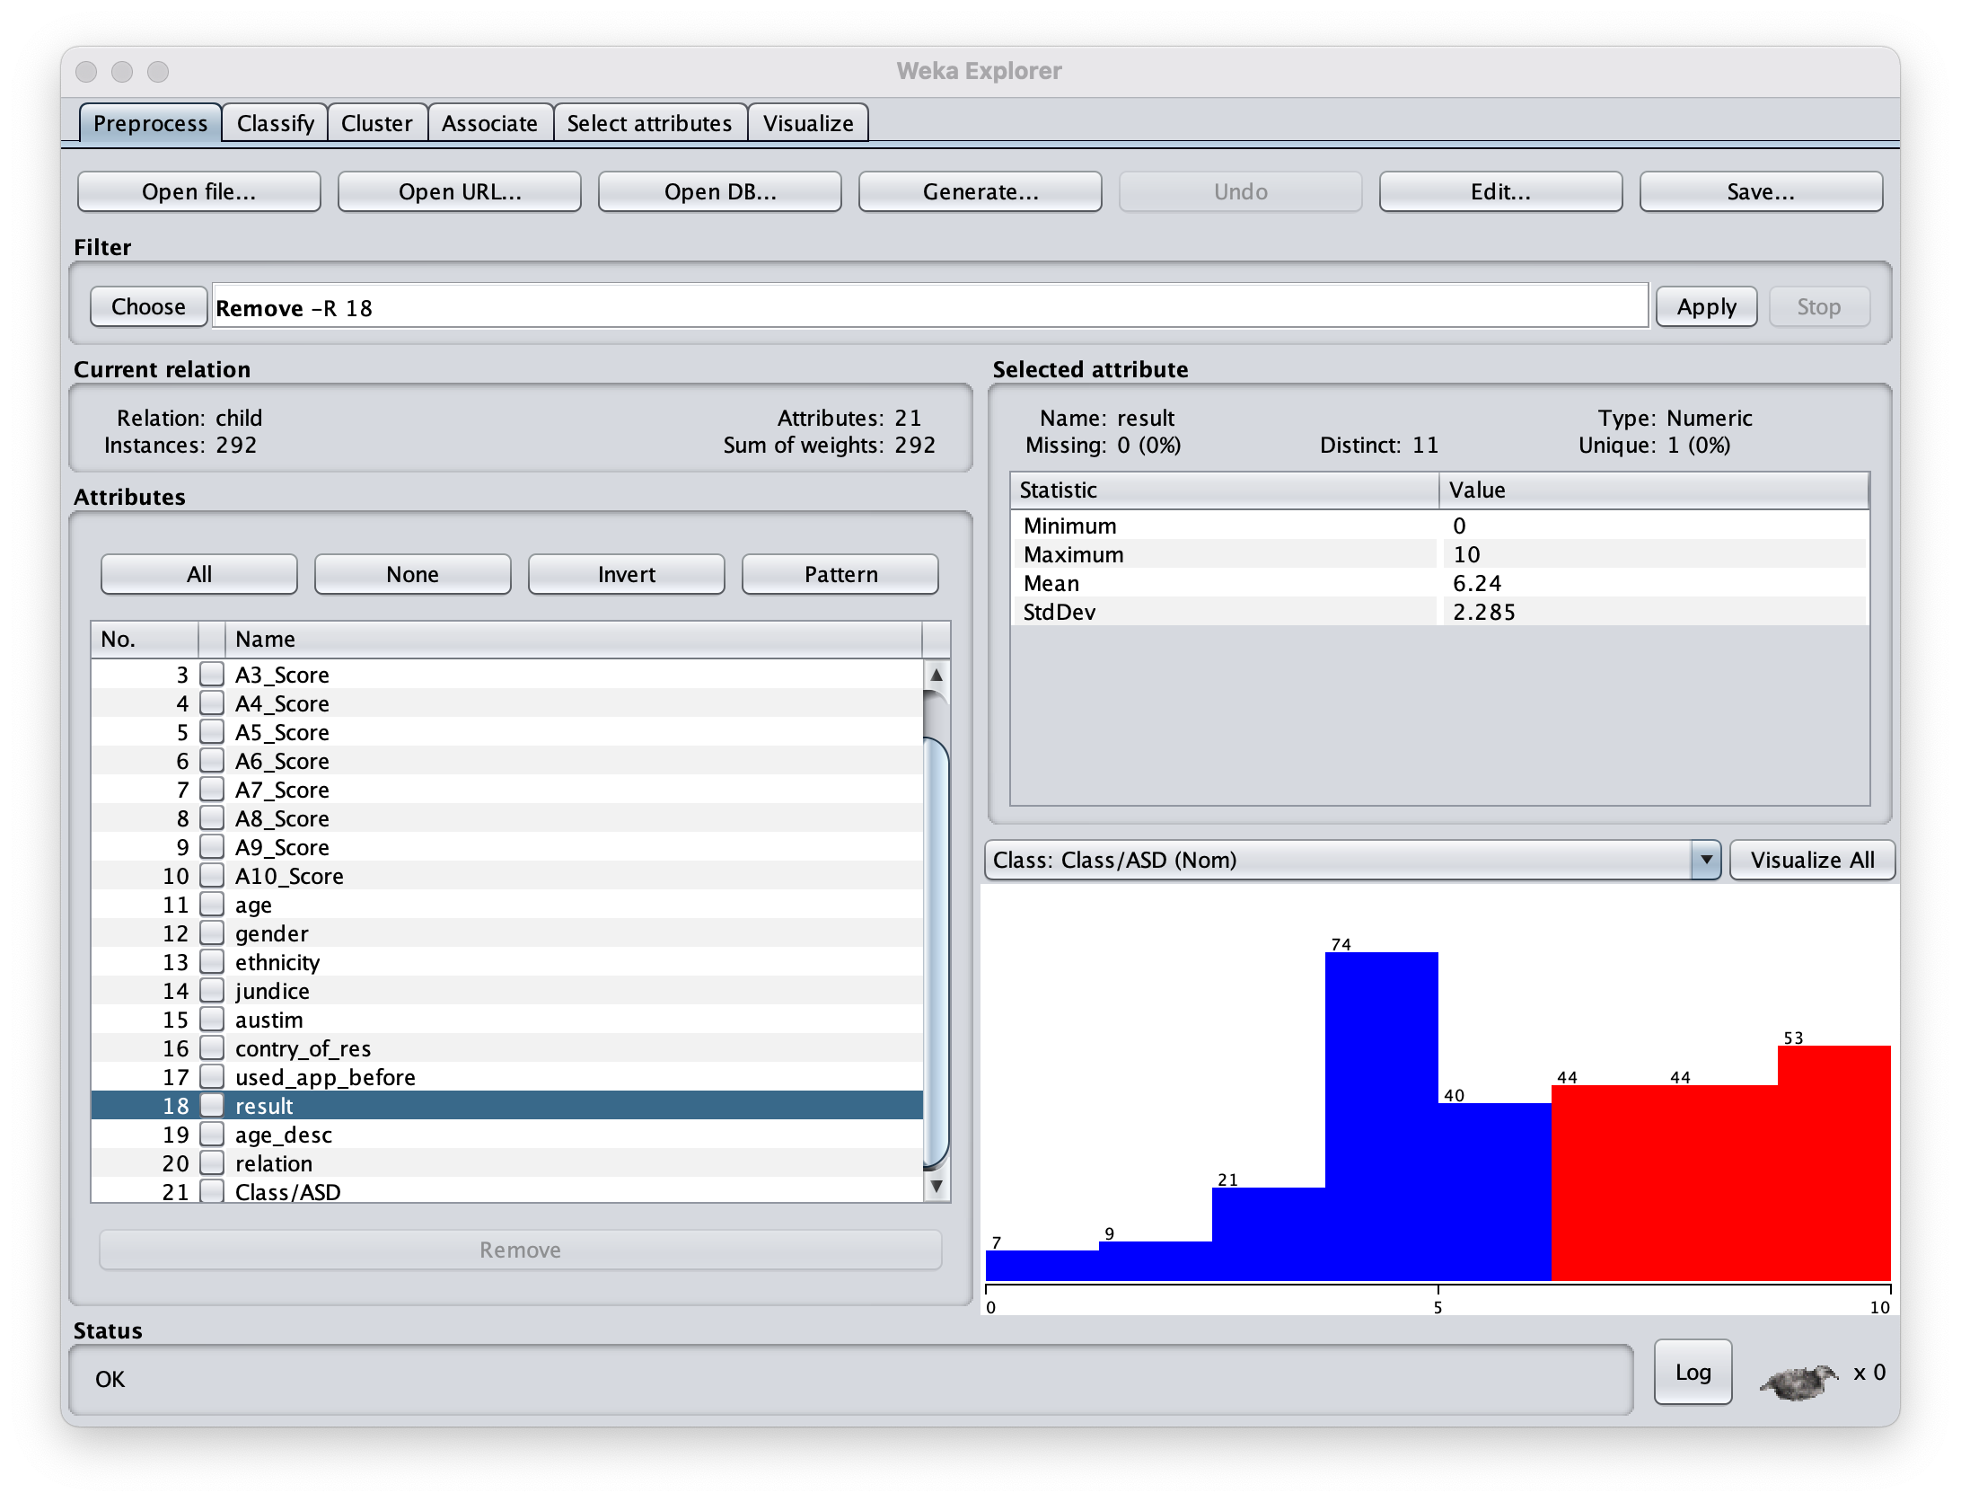
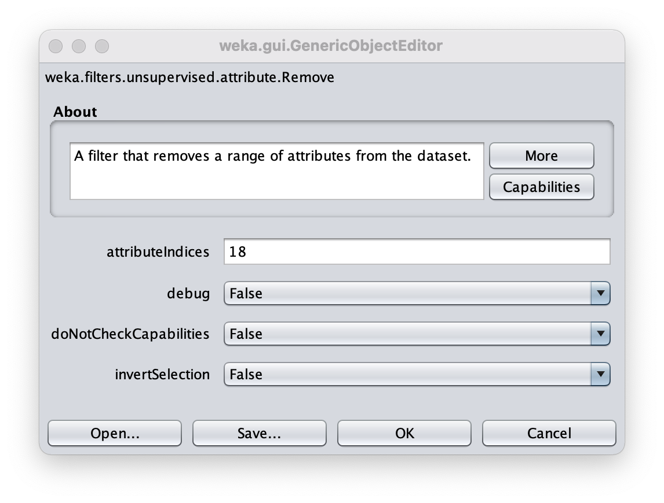
I’m too busy for EDA – just hit classify already
Screening Score | Integer | The final score obtained based on the scoring algorithm of the screening method used. This was computed in an automated manner
The result variable is the study’s calculated score from 1-10 for predicting
Looks like anything above a 6 predicts Autism… what data did they use?
Let’s remove this feature. Choose -> filters -> unsupervised -> Remove
Then, click ”Remove” to indicate we want the 18th attribute removed.
Finally, Click “Apply”.

Slide 23
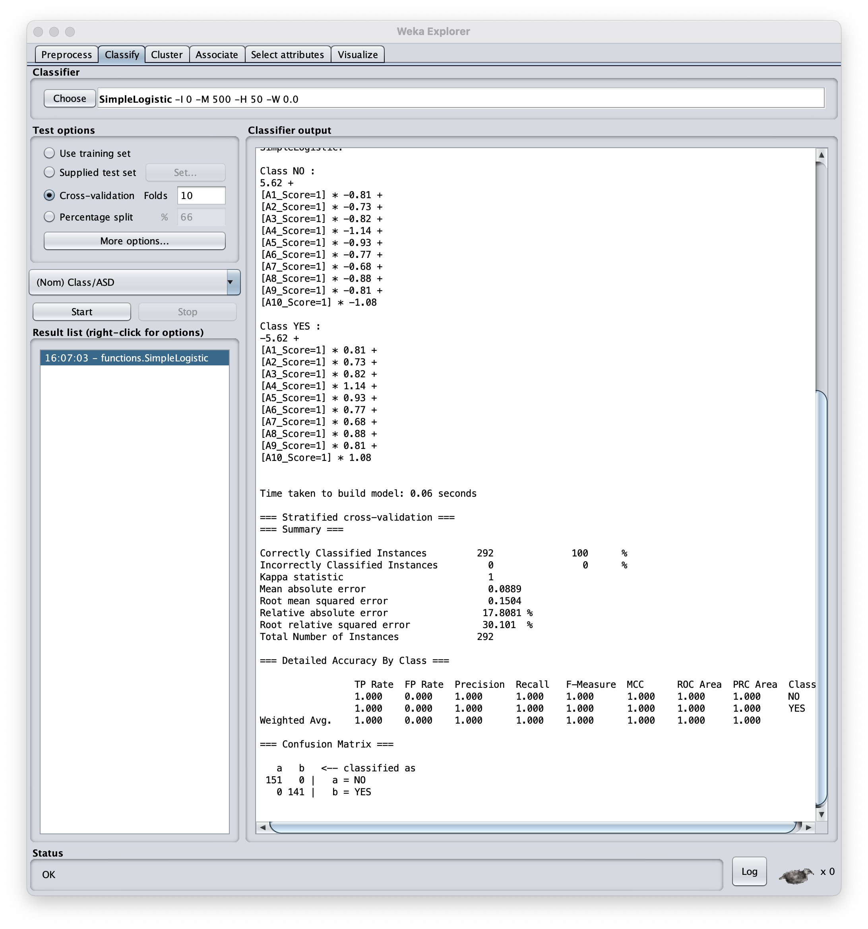
Now we can compare feature importance:
Still 100% accuracy?
Only the A1-10 questions survived the feature selection.
Demographics and other clinical variables not important to this model.
A4 score is most associated with Autism diagnosis.
A7 score is least associated with Autism.

Slide 24
Why was the data collected? Think bout how the data was intended to be used.
Who was the author? Can inform your understanding of the data’s purpose.
What does the literature say? Cohorts and datasets are often well studied. (important features, clinical need)
What do the values represent vs what are they trying to represent.
Rectangular data : observational unit (samples), features (variables), classes (outcomes)
Categorical VS continuous features – (African American, Caucasian, Hispanic ) vs (height, weight, age)
Distribution/frequency/density –
Boundaries
Are there any holes
What is distance between values/categories
Infs and missing values
Normally distributed
Prevelance
Ordered:
Categorical on a scale of 1 to 5
Words in a sentence like the pangram “The quick brown fox jumps over the lazy dog.”
Amino acids in a protein sequence
Time-ordered like the in the molecular dynamics at the Newtonian level or the exciton transport at the quantum level
Fluctuating stock prices

Slide 25
QA/QC issues:
Was the data manually entered? – do features have values like “day1”, ”Day2”, day 3”
What are limits of detection for measurements? 1 millimole , 1 centimeter, 1 K, 1 second
Do measurements between days or sessions drift? Batch effects
Where are the feature outliers?
Do outliers in one feature tend to also be outliers in another?
Are the mean, median, and mode similar?
Are there any features with near zero variance?
Are there any overwhelming categories?
Correlations
How are features associated with the classes? Rsquared, t-tests
Do categories have similar class distributions?
Are features correlated? Redundant data, Heatmaps, dimension reduction
Formatting, treat missing, transformations, feature selection -> Tidy data

Slide 26
Hypothesis Generation vs Hypothesis Testing
Exploratory Data Analysis
Statistical analyses aimed to discover important relationships in order to suggest hypotheses to test.
[ Histograms | Box Plots | Correlation Matrices | Principal Components ]
Statistical Hypothesis Testing
Statistical inference based on the predicted outcomes resulting from hypothesis relative to some alternative hypotheses. (How confident are we the observed outcomes result from an actual relationship rather than just by coincidence?)
[ Sensitivity | Specificity | P-values ]
Notes:
Confirmation bias -

Slide 27
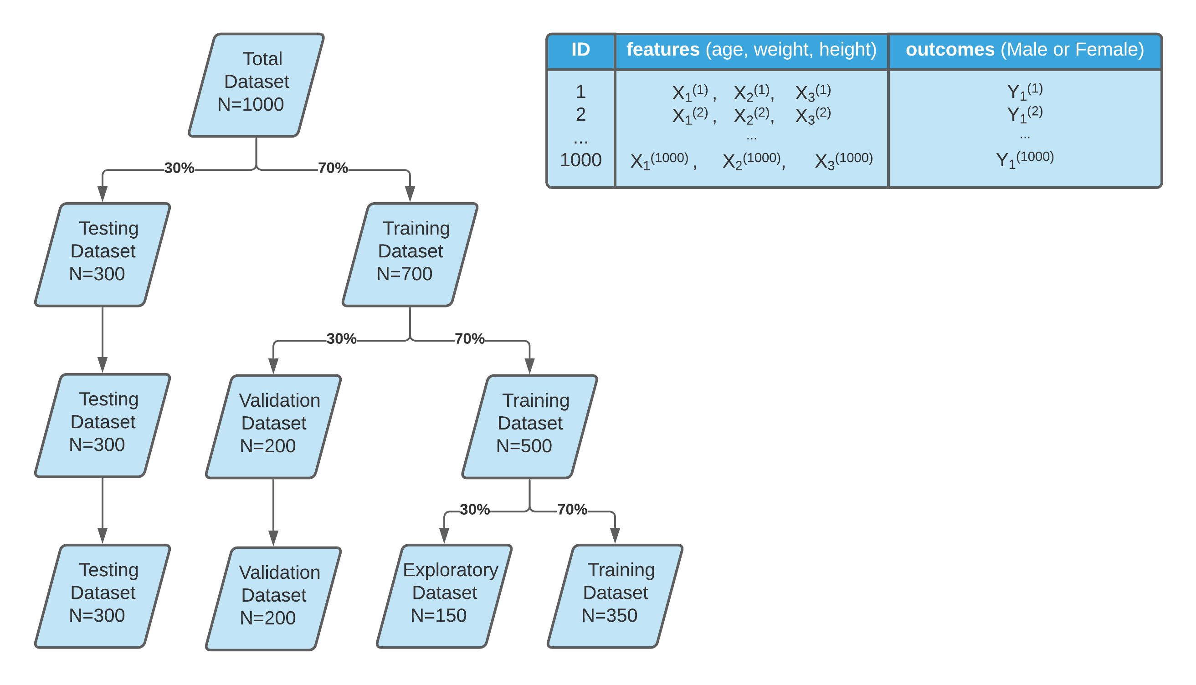

Slide 28
Getting to know your data
Lew M.J. (2019) A Reckless Guide to P-values. In: Bespalov A., Michel M., Steckler T. (eds) Good Research Practice in Non-Clinical Pharmacology and Biomedicine. Handbook of Experimental Pharmacology, vol 257. Springer, Cham. https://doi.org/10.1007/164_2019_286

Slide 29
On P-values
Culprits
Misunderstood
Misapplied
Answer questions no on asks
Unintentional p-hacking

Slide 30
Hypothesis test and Significance test
P < 0.05 is arbitray (but not unreasonable)
Neyman 1933: Type 1 erros (FP) and errors type 2 errors (FN) to formalize the concept of power.
More N = better Stats, More N = More $$$
Long deep history has crystalized p>0.05 dogma.
Frequentist approach can only reject the Null hypothesis.

Slide 31
Contradictory Instructions
Sometimes details of experiments cannot be reproduced 100%.
Judgments and debates on what is appropriate often driven by conviction rather than data.
P-value dogma -> conviction

Slide 32
P-values are not linear

Slide 33
Story telling and P-hacking

Slide 36
EDA slide
PCA interactive tool how it works

Slide 37


Slide 38
One layer deep = linear regression
Visualize one layer deep model (use this fig when teaching regression)

Slide 39
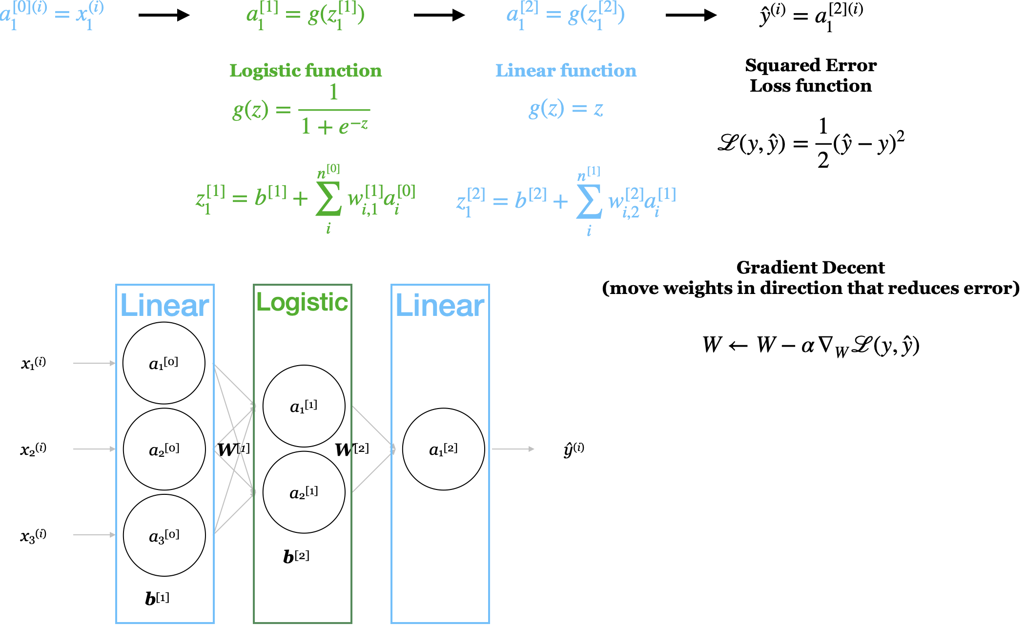
Notes:
Big sigma scary –figure for gratident decent

Slide 40
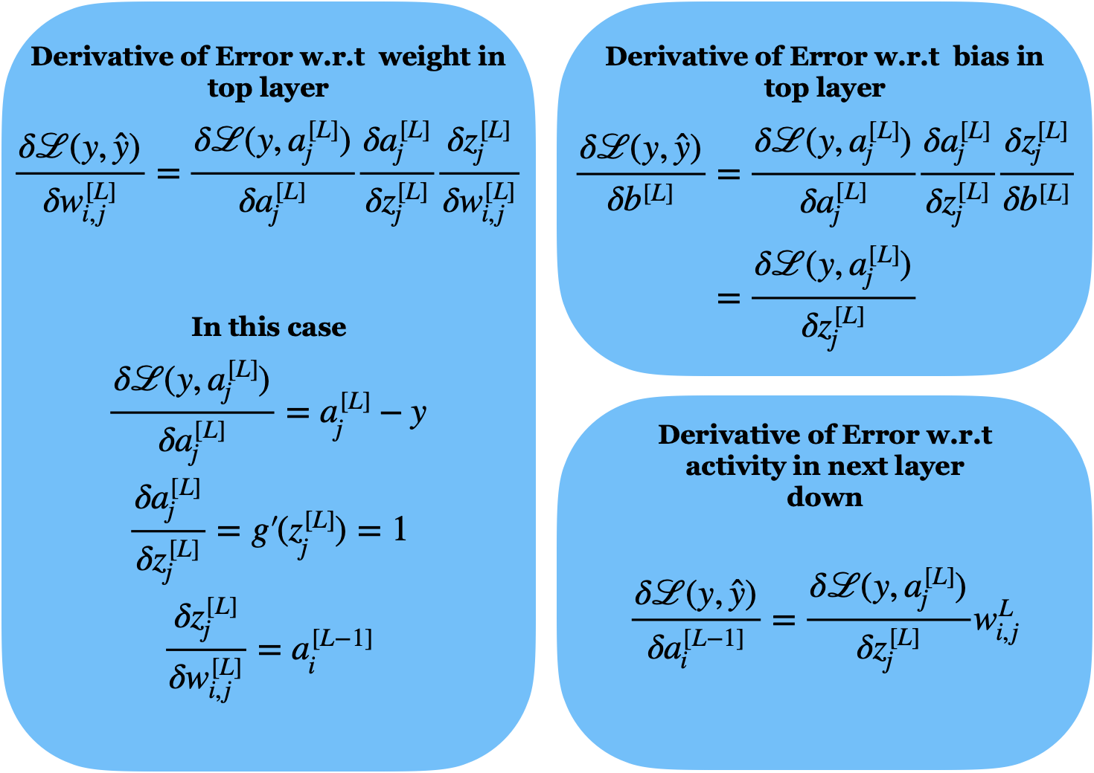

Slide 41
Cool examples

Slide 42
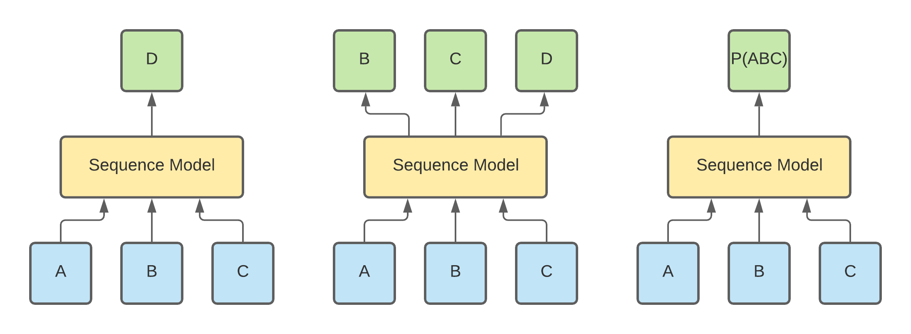
Notes:
GP3 – NPL examples

Slide 43
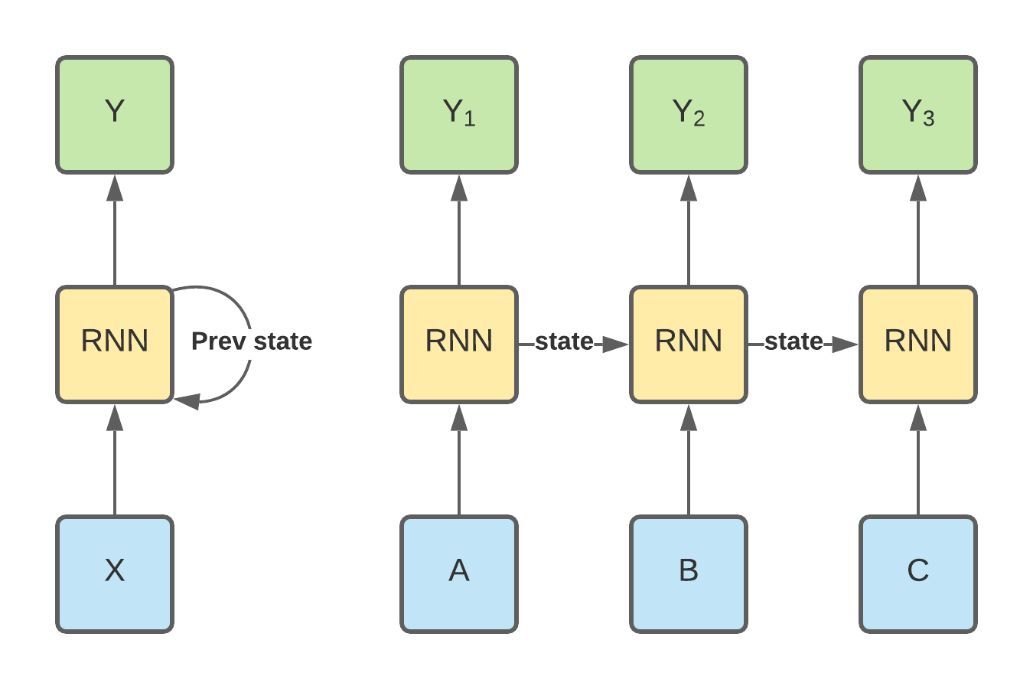

Slide 44
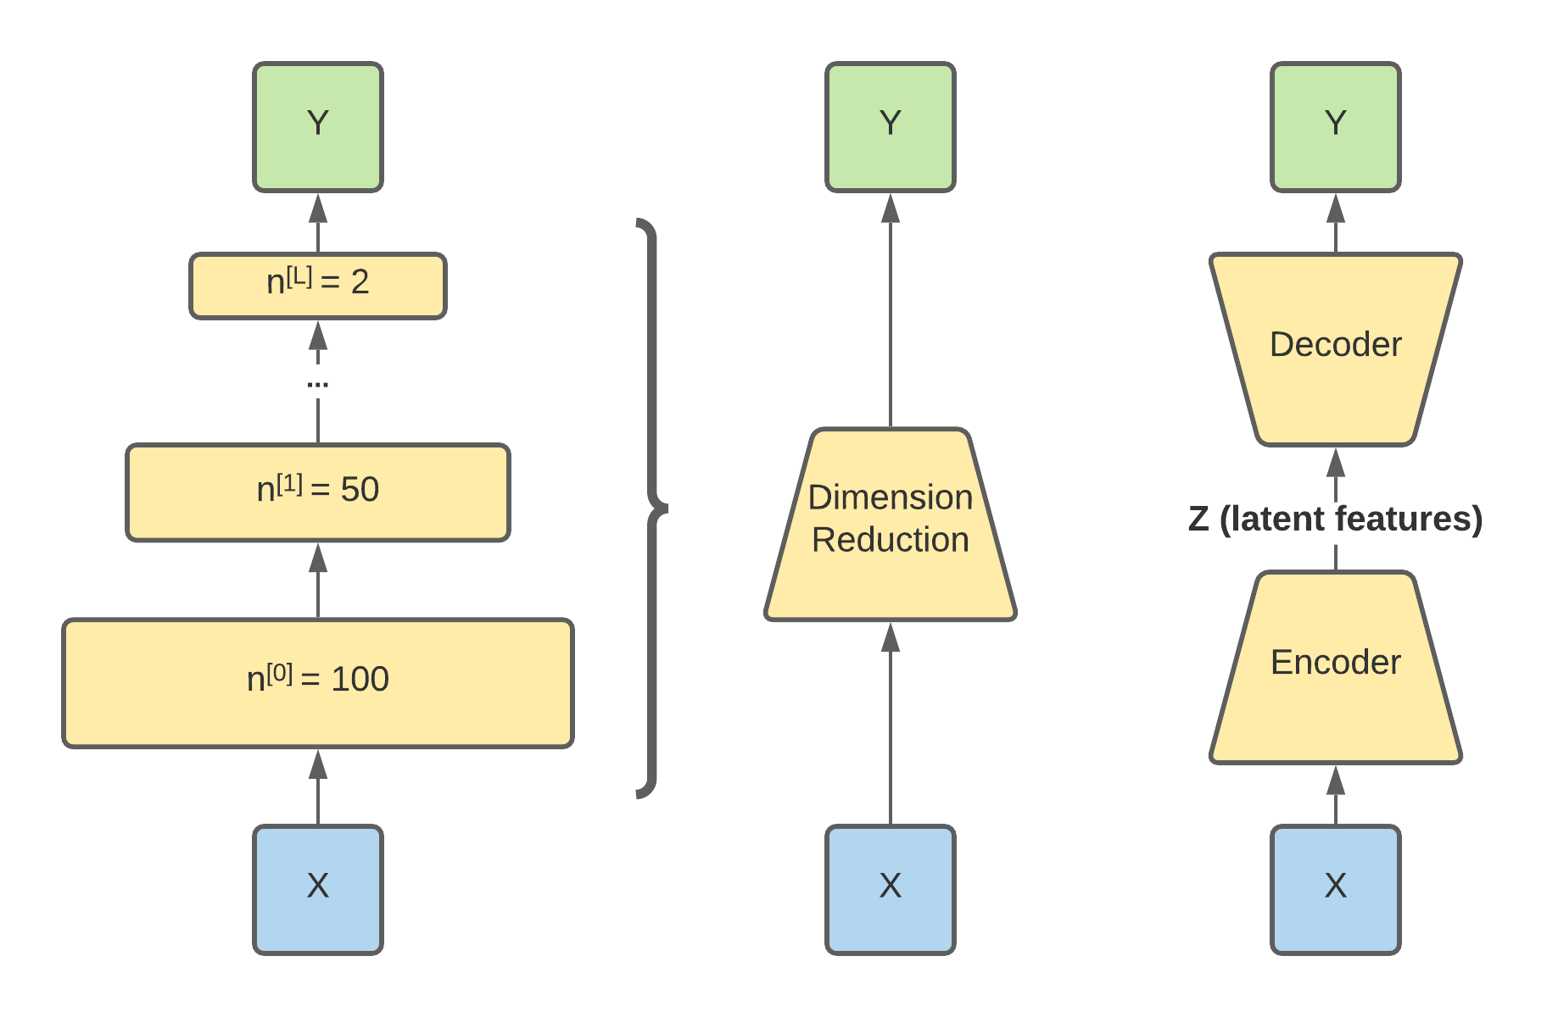

Slide 45
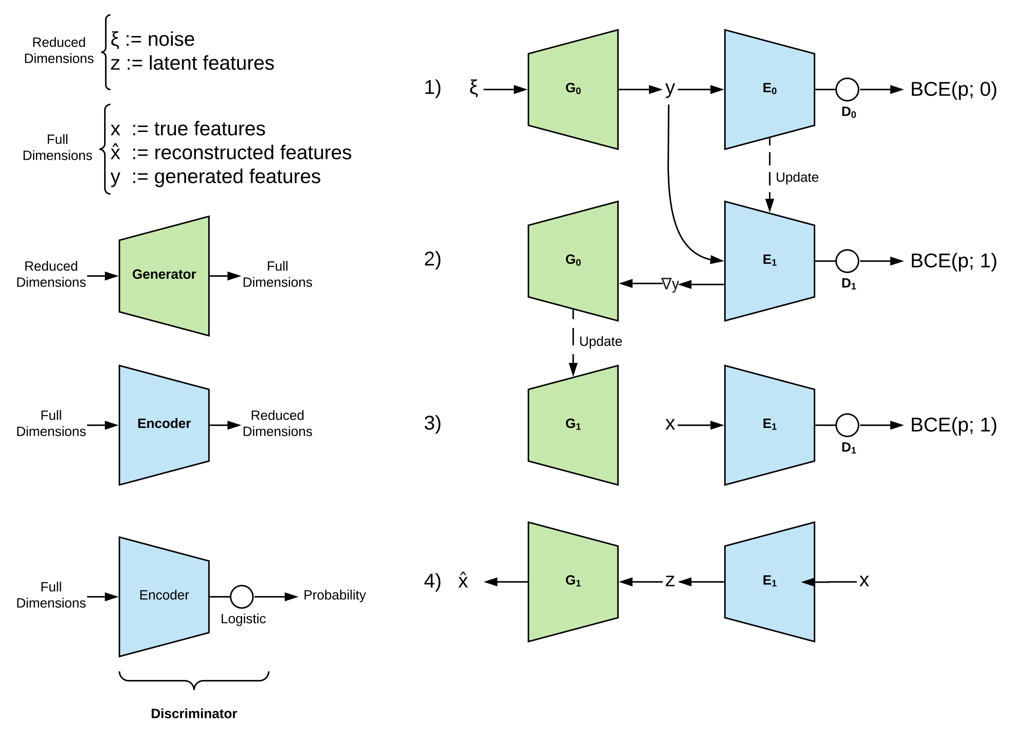
Generative
Adversarial
Networks
Notes:
Deep fakes and spoofing

Slide 46

Notes:
Bite sized

